Slide 1
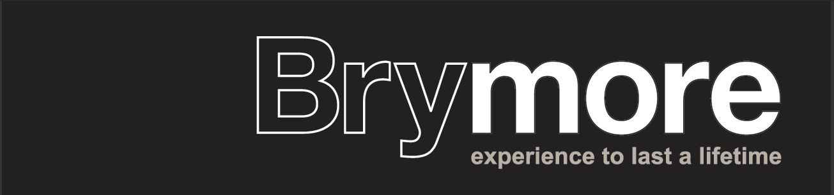
Y11 Raising Achievement in English
2017

Slide 2
1-9 GCSE English Literature & Language - Edexcel
English Literature
Paper 1 (Macbeth & Blood Brothers): Monday 22nd May
Paper 2 (Jekyll & Hyde &poetry): Friday 26th May
English Language
Paper 1 (unseen 19th century fiction & creative writing): Tuesday 6th June
Paper 2 (comparing unseen 20th&21st century non fiction & transactional writing): Monday 12th June

Slide 3
Y11 Raising Achievement in English Literature

Slide 4
English Literature Paper 1 – 22nd May 2017 (50%)
Section A: Macbeth 55 minutes
Section B: Blood Brothers 50 minutes
1 extract from anywhere in the play – ‘How’ question.
1 question knowledge of whole play (likely thematic)
Choice of 2 questions
  Character
  Setting
  Theme
  techniques
20% - GPaS

Slide 5
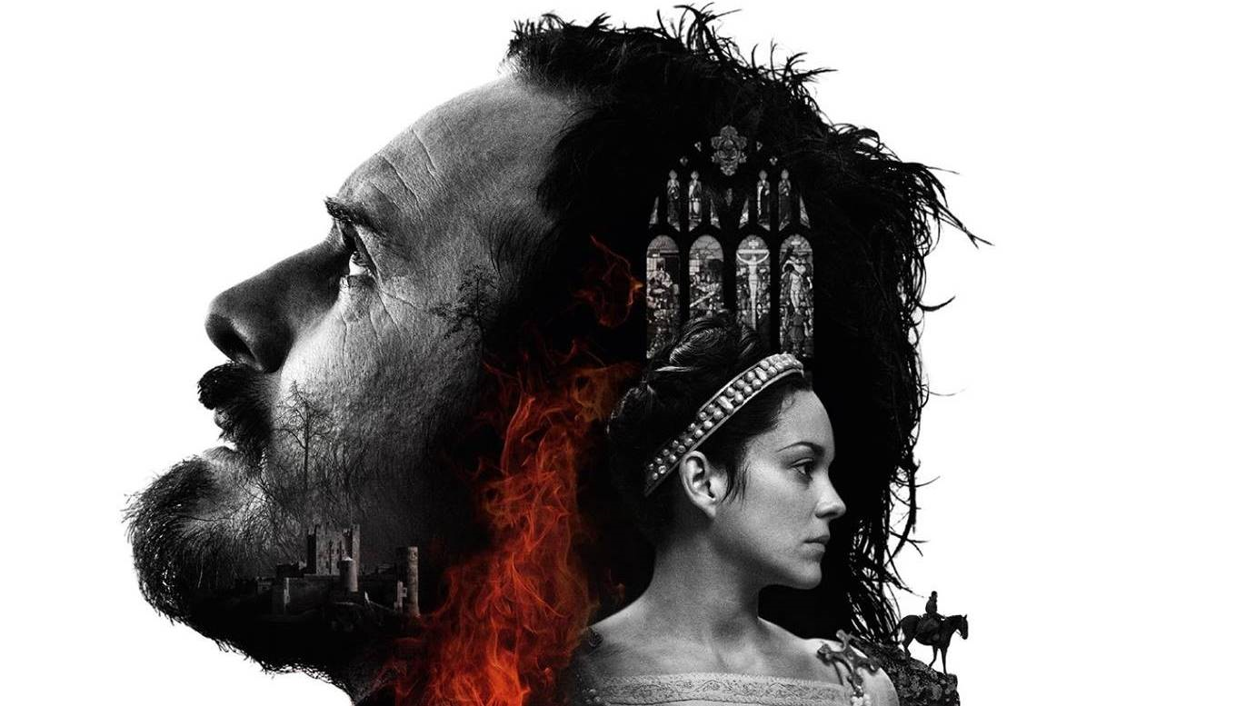
Section A – ‘Macbeth’

Slide 6
Question A
Extract based
20 marks
27.5 minutes
1 minute unpicking question and making sure you understand the focus.
6.5 minutes reading extract and annotating – identifying language, techniques and structure – effect & link to question
20 minutes writing – 2 pages

Slide 7
Only 2 criteria
Ability to ANALYSE the effect of language, structure and techniques
Ability to use correct terminology

Slide 8
How does Shakespeare use language to show the changing relationship between Macbeth and Banquo? (20)
Language, structure, techniques?
‘Thou hast it now: king, Cawdor, Glamis, all,
As the weird women promised, and, yet I fear,
Thou play’dst most foully for it

Slide 9
Language, structure, techniques?
Soliloquy – Banquo no longer trusts Macbeth enough to discuss his true feelings
Triplet – makes Macbeth seem powerful. Banquo realises that the witches are a dark, evil force to be taken seriously.
‘play’dst’ - Banquo is hinting that Macbeth doesn’t appreciate the severity of his actions. He is treating it like a game he doesn’t want to lose.
‘Thou hast it now: king, Cawdor, Glamis, all,
As the weird women promised, and, yet I fear,
Thou play’dst most foully for it
Repetition of ‘Thou’ implies Banquo is accusing Macbeth – he no longer trusts him
‘foully’ reminiscent of the language used by the witches – Banquo fears the influence they have over Macbeth
‘Fear’ suggests Banquo is scared of Macbeth’s capabilities – probably justifiably so given his record in battle

Slide 10
From the extract we learn that Banquo no longer trusts Macbeth as he delivers his true thoughts and feelings about recent events to the audience through a soliloquy. Banquo’s use of the second person and repetition of ‘Thou’ makes his tone seem accusatory, again signifying that he no longer trusts his former friend and confidant. The use of the triplet, ‘king, Cawdor, Glamis’ makes Macbeth seem powerful and possibly intimidating to Macbeth; it also reinforces the idea that the witches are a dark and evil force to be taken seriously. Shakespeare’s choice of language for Banquo is also revealing about how he feels about Macbeth. For example, ‘fear’ suggests Banquo is scared of Macbeth’s capabilities – probably justifiably so given his record in battle. Furthermore, ‘foully’ is reminiscent of the language used by the witches suggesting that Banquo fears the influence they have over Macbeth. Lastly, by using the word ‘play’dst,’ Banquo (Shakespeare) is hinting that Macbeth doesn’t appreciate the severity of his actions. He is treating it like a game he doesn’t want to lose.

Slide 11
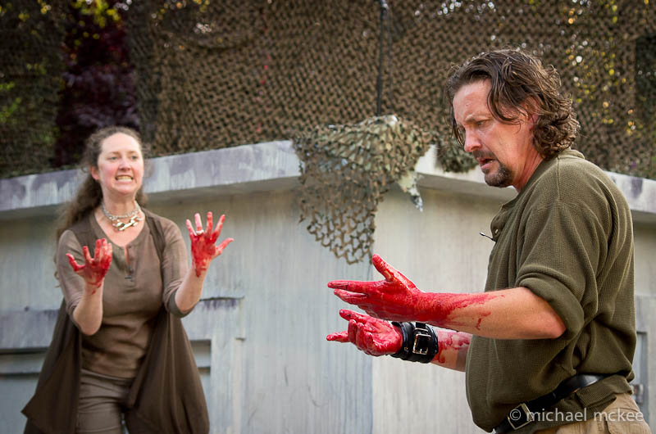
Macbeth after the murder

Slide 12
Language, structure, techniques?
How does Shakespeare use language to show Macbeth’s state of mind? (20)
ACT 2, scene 2
Macbeth:
But why could I not pronounce ‘amen’?
I had most need of blessing and ‘amen’ stuck in my throat…..

Slide 13
Language, structure, techniques?
How does Shakespeare use language to show Macbeth’s state of mind? (20)
ACT 2, scene 2
Macbeth:
But why could I not pronounce ‘amen’?
I had most need of blessing and ‘amen’ stuck in my throat…..
Structure: Question suggests he is confused, questioning himself, lost
Technique: Repetition of ‘amen’ juxtaposed with ‘stuck’ suggests he is a stuck record, fixating, unable to move forward – links to ‘Sleep no more, Glamis hath murdered sleep.’
Religious language – torn between God and the devil

Slide 14
Language, structure, techniques?
Language: strong word – appal – Macbeth is terrified- perhaps appalled at himself
Macbeth:
‘Whence is that knocking?
How is it with me when every noise appals me?’
Structure: Yet more questions – goes from ‘why’ to ‘where’ to ‘how’ – he is lost.
Technique: Noises – Shakespeare adds an eery quality to the scene with the knock, like a heartbeat, externalising Macbeth’s inner turmoil. Is the devil knocking on his soul?

Slide 15
Language, structure, techniques?
Macbeth:
What hands are here?
Ha – they pluck out mine eyes.
Will all great Neptune’s ocean wash this blood clean from my hand?
No…’

Slide 16
How does language show Macbeth’s state of mind?
Shakespeare uses several questions to reveal that Macbeth is lost. He begins with ‘why’, moves to ‘whence’, then to ‘how’, followed by ‘what’ and ‘will’. It is as if he has no idea where he is or who he is anymore – the world has become a dangerous, alien place after the murder. We see the first signs of madness in the repetition of ‘amen’ and his paranoid response to noises. Shakespeare uses the knocking as a metaphor to represent the knocking of the devil on Macbeth’s soul. The language used ranges from religious words such as ‘amen’ and blessing’ which contrast with violent words like ‘appal’ and ‘pluck’ to show Macbeth is torn between good and evil. The imagery of Neptune’s ocean shows how awful Macbeth feels about what he has done – even the ocean will not free him of it. This contrasts with Lady Macbeth’s ‘a little water clears us of this deed.’

Slide 17
Section A checklist (reading)
Understand focus of question
Read with a purpose -ANNOTATE
Identify 3-5 quotes (depending on scope for analysis.)
Annotate your selected quotes on your extract:
  Connotations of words/relevance/cross-reference?
  Techniques – effect?
  Structural features – effect?

Slide 18
Section A checklist writing (20 minutes) 1-2 pages
Topic sentences linked to focus of question (character of Banquo)
Clear points supported by relevant quotes
Work chronologically through extract
Analysis of language, structure and technique
Inclusion of relevant terminology
Language for analysis.

Slide 19
Question B
In the extract we see Banquo checking his ambition. Explore the significance of ambition elsewhere in the play. (20)

Slide 20
Where else in the play do we see ambition?
Act 1 scene 4
Act 1 scene 5
Act 2 scene 2
Act 3 scene 1
Act 3 scene 3
Act 4 scene 2
X

Slide 21
Ambition can also be seen in Act 1 scene 4 when Macbeth shows through his own free will that he is ambitious independently of his wife. King Duncan announces his heir and makes Malcom the Prince of Cumberland. Macbeth reveals his sinister ambitions for the first time. He says “The Prince of Cumberland! That is a step On which I must fall down or else o’erleap” and “For in my way it lies.” “Stars, hold your fires, Let not light see by deep and black desires.” Shakespeare uses a metaphor to reinforce that even Macbeth knows this ambition is wrong, comparing Malcolm to a step dehumanises him. This is further supported by him acknowledging that his desires are ‘black’ and he wants them to remain hidden. In Jacobean England it was treason to even speak of the death of a king. To challenge the role of a king was to challenge the word of God as they believed in the Divine Right of Kings. As a deeply religious society people may be able to face the wrath of a king, but were unlikely to accept the eternal damnation of their soul. Shakespeare here is deliberately trying to appeal to England’s newest monarch, acting as his spin doctor.

Slide 22
Question B – to get 4+
CANNOT talk about the extract
MUST have a relevant personal response (don’t just re-tell events)
Must be developed
Focussed to the question
Use references/quotes from the play
Show an understanding of author’s purpose/intent
Link to social & historical context

Slide 23
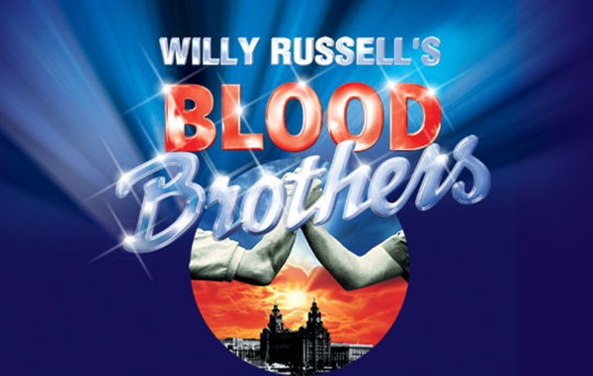
Section B- ‘Blood Brothers’

Slide 24
Section B- 50 minutes, 40 marks (32+8)
Choice of 2 questions
1 minutes selecting
5 minutes planning
39 minutes writing
5 minutes proof reading

Slide 25
How does Russell explore the theme of superstition and fate in Blood Brothers?

Slide 26
And do we blame superstition for what came to pass? Or could it be what we, the English, have come to know as class? The role of superstition is primarily a device to support Russell’s view that one’s success was dependent on one’s class. The middle classes had the better education, qualifications, jobs, earning potential and standards of living. In contrast, the working classes had the exact opposite, what with the closing of traditional manufacturing and mining industries, they were destined to be trapped in a relentless cycle of poverty and deprivation. Superstition, to an educated, rational person, is not something to be taken seriously. Hence rendering Russell’s perhaps most famous quote from the play as a rhetorical question – class must be to blame for the tragedy.

Slide 27
Mrs Johnstone is superstitious Mrs Johnstone is horrified when Mrs Lyons places new shoes on the table, revealing that she is superstitious. “You never put new shoes on the table.” Superstition is immediately linked to the working class, because Mrs Johnstone is superstitious whereas Mrs Lyons isn’t. This gives Mrs Lyons power over her employee when she wants to make sure that Mrs Johnstone doesn’t tell anyone about the twins being split up. To do this she makes up a superstition about the twins Mrs Lyons uses her knowledge that Mrs Johnstone is superstitious to ensure that she does not tell anyone about giving away one of the twins. “They … they say that if either twin learns that he once was a pair, they shall both immediately die.” This becomes a self-fulfilling prophecy. This is dramatic irony because the audience is already aware that the twins will die because of the opening of the play, so everything that happens is linked to this. Although Mrs Lyons has invented the superstition, her behaviour actually leads to the tragedy of Mickey’s death because she is the one to point out to him that Edward and Linda have betrayed him. During the time when Mrs Johnstone would have grown up, in the 1950s and 1960s the education system favoured the middle and upper classes. Mrs Johnstone would have attended a secondary modern which would have likely been attended by children from a deprived area with little or no aspirations. Behaviour would have likely to have been poor and achievement low. Without a good education, people like Mrs Johnstone would become trapped in a cycle of poverty with no way of being able to improve their lives.

Slide 28
For a grade 4/5
The response shows a relevant personal response, soundly related to the text with focused supporting textual references.
There is an appropriate critical style, with comments showing a sound interpretation with focused supporting textual references.
Sound comment is offered on relevant contexts.
There is relevant comment on the relationship between text and context.

Slide 29
English Literature Paper 2 – 26th May 2017 (50%)
Section A: Jekyll & Hyde 55 minutes
Section B: Poetry anthology & unseen poetry – 1 hr 20
1 extract from anywhere in the novella – ‘How’ question.
1 question knowledge of whole play (likely thematic)
One poem from conflict cluster – will have to compare to one other poem from cluster from memory.
2 unseen poems – comparative essay

Slide 30
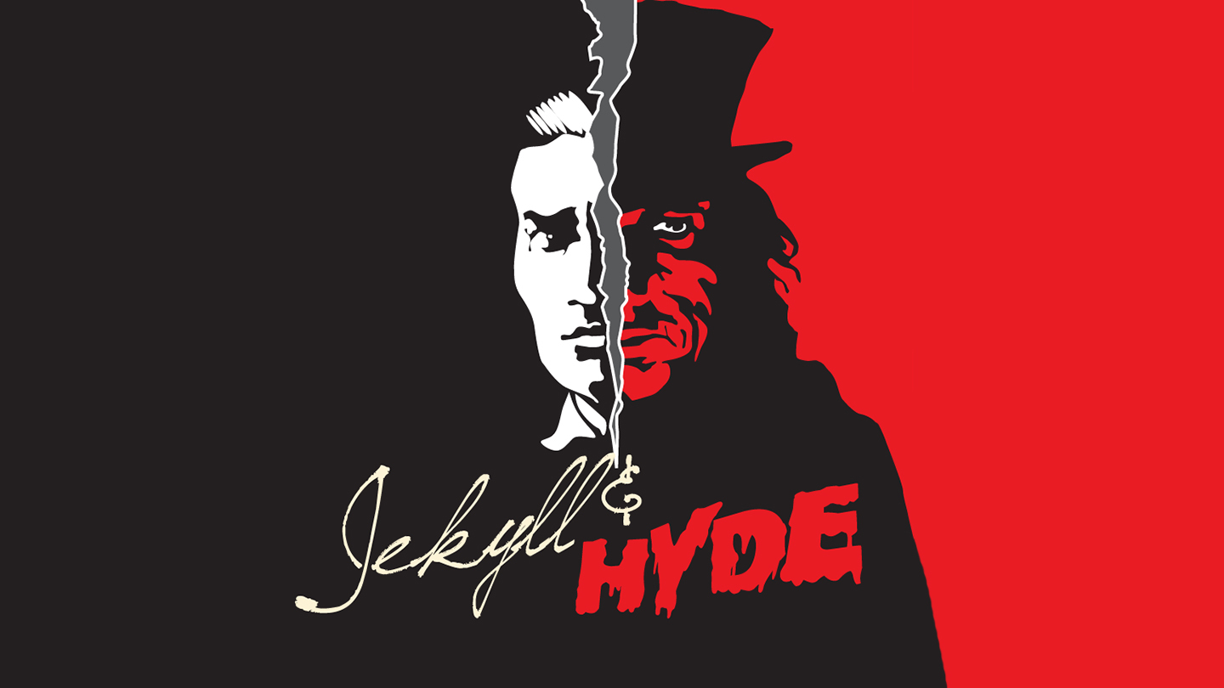
Section A

Slide 31
Section A
Question a = extract based. ‘How’ question marked on same criteria as Macbeth
Question B – knowledge of whole text – same as Macbeth

Slide 32
Language, structure, techniques?
"He is not easy to describe. There is something wrong with his appearance; something displeasing, something down-right detestable. I never saw a man I so disliked, and yet I scarce know why. He must be deformed somewhere; he gives a strong feeling of deformity, although I couldn't specify the point.”
Structure; Short, snappy sentence – hooks us into the mystery
Technique: Triplet, repeating something – builds tension
Language: words linked to evil – most starting with ‘d’ – hint at the devil?

Slide 33
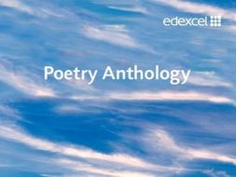
Section B= Poetry
Conflict

Slide 34
Catrin
I can remember you, child,
As I stood in a hot, white
Room at the window watching
The people and cars taking
Turn at the traffic lights.
I can remember you, our first
Fierce confrontation, the tight
Red rope of love which we both
Fought over. It was a square
Environmental blank, disinfected
Of paintings or toys. I wrote
All over the walls with my
Words, coloured the clean squares
With the wild, tender circles
Of our struggle to become
Separate. We want, we shouted,
To be two, to be ourselves.
Neither won nor lost the struggle
In the glass tank clouded with feelings
Which changed us both. Still I am fighting
You off, as you stand there
With your straight, strong, long
Brown hair and your rosy,
Defiant glare, bringing up
From the heart’s pool that old rope,
Tightening about my life,
Trailing love and conflict,
As you ask may you skate
In the dark, for one more hour.
Gillian Clarke (1978)
Section B.1 = 35 minutes
10 minutes planning
25 minutes writing
Re-read Catrin. Choose one other poem from the Conflict anthology.
Compare how tension is presented in the two poems.
In your answer you should consider the:
• poets’ use of language, form and structure
• the influence of the contexts in which the poems were written.
(Total for Question 9 = 20 marks)

Slide 35
PLAN FIRST!
SMILE! | ‘Catrin’ | Compare/ contrast | ‘A Poison Tree’
STRUCTURE
MEANING | Tension builds between a mother and child from the moment of birth through to adolescence | whereas | Tension builds between what we believe to be two peers when anger is not expressed and left to fester.
IMAGERY & TECHNIQUES
LANGUAGE
EMOTIVE TONE

Slide 36
Section B.ii = unseen poetry
45 minutes
Same process but slightly longer
Same marks scheme BUT no need to have an awareness of context.
Must plan first

Slide 37
Success criteria for 4+
Plan
Must write about 2 poems to get above a grade 3
Have to show an understanding of structure and the effects of structural choices
Must analyse language – single word analysis
Must show a sound understanding of poetic terminology
Must show an awareness of context (Bi)

Slide 38
Literature – Poetry content
You don’t have to know all 15 by heart – re-read them all but try to learn between 3-5 well!
WAR – ‘Charge of the Light Brigade’
SOCIAL – ‘No Problem’
POLITICAL – ‘Belfast Confetti’
MORAL – ‘War Photographer’
Learn your techniques!

Slide 39

What and how to revise for Literature

Slide 40
For each text you must revise and have an understanding of:
Context
Plot & chronology
Characters
Settings
Themes

Slide 41
Context
MACBETH | BLOOD BROTHERS | JEKYLL & HYDE
The real Macbeth James I & The Divine Right of Kings Role of witchcraft in Jacobean society Gunpowder Plot & significance of treason The role of men and women in Jacobean society | Willy Russell Liverpool The people/culture of Liverpool Politics – Margaret Thatcher & the conservative party Education – grammar vs secondary modern Poverty Council housing ‘New towns’ | Stevenson Victorian London Victorian gentlemen Religion Science Jack the Ripper – duality of man

Slide 42
Plot & chronology
Timeline/flow chart
Comprehension questions (already been given them & in subject resources)

Slide 43
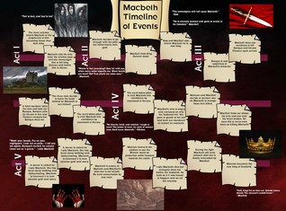

Slide 44
Character profiles
MACBETH | BLOOD BROTHERS | JEKYLL & HYDE
Macbeth Lady Macbeth Banquo Lennox Witches/Hecate | Mickey Edward Mrs J Mrs L Sammy Linda | Jekyll/Hyde Utterson Lanyon Poole

Slide 45
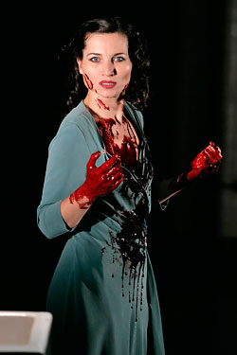
Cruel
She would “dash the brains out” of her own child
She is calculating She says look "innocent" but be a "serpent"

Slide 46
Themes
Where we see it
Quotes
Author’s message/point
Link to context
Make themes maps/practise writing theme answers.

Slide 47
Macbeth, although undoubtedly influenced by his wife in the following scene, in Act 1 scene 4 he shows through his own free will that he is ambitious independently of his wife. King Duncan announces his heir and makes Malcom the Prince of Cumberland. Macbeth reveals his sinister ambitions for the first time. He says “The Prince of Cumberland! That is a step On which I must fall down or else o’erleap” and “For in my way it lies.” “Stars, hold your fires, Let not light see by deep and black desires.” Shakespeare uses a metaphor to reinforce that even Macbeth knows this ambition is wrong, comparing Malcolm to a step dehumanises him. This is further supported by him acknowledging that his desires are ‘black’ and he wants them to remain hidden. In Jacobean England it was treason to even speak of the death of a king. To challenge the role of a king was to challenge the word of God as they believed in the Divine Right of Kings. As a deeply religious society people may be able to face the wrath of a king, but were unlikely to accept the eternal damnation of their soul
We first see LM’s ambition in Act 1 scene 5 when she reads the letter sent to her by her husband telling her of the three prophesises the witches made. It is her ambition that makes her decide that her husband ‘shalt be what thou art promised.’ We also see the lengths she will go to to see her ambitions fulfilled. She asks the spirits to ‘unsex me here and fill me from the crown to the toe top full of direst cruelty.’ It is in this scene that Lady Macbeth plots the murder of Duncan and sets about manipulating her husband into complying with her treasonous plans. This would have been disturbing to a Jacobean audience who saw women as the weaker sex; the thought of them interfering in the world of politics, let alone questioning her husband’s masculinity, would have been unthinkable. Lady Macbeth also seems to have links to the supernatural, women were believed at the time more likely to be witches. Women manipulating men and leading them astray is nothing new, stemming from Eve’s actions in the Garden of Eden.
The witches first speak Macbeth’s ambition in Act 1 scene 3 when they predict that he will become Thane of Cawdor and then ‘hail king that shalt be.’ This would have appealed to a Jacobean audience who believed in witches and believed them to be ruled by the dark forces of the devil who looked to lead people astray. King James would also have identified with the witches as he especially had an interest in them, so much so he wrote a book about them called Demonologie.
Ambition
Banquo could also be argued to be ambitious in Act 3 scene 1 when he says ‘why, by the verities on thee made good, May they not be my oracles as well, And set me up in hope?’ He starts to think that as the witches predictions regarding Macbeth have come true maybe he really could be father to a line of kings. Banquo here is used as a contrast to Macbeth. Macbeth allows his ambition to corrupt him whereas Banquo’s ambition is constrained by his morals, ‘But hush! No more.’
Macbeth proves the lengths that he will go to in order to see his ambition come to fruition in Act 2 scene 2 when he commits regicide and murders Duncan. Although he has doubts and his feelings of guilt cause him to hallucinate, ‘is this a dagger I see before me?’, this doesn’t stop him. The consequences of ambition can already start to be seen Lady Macbeth says she ‘heard the owl scream and the crickets cry.’ ‘Scream’ echoes the horror of the murder and the pain that must have been endured by Duncan. ‘Cry’ suggests that nature if mourning the upset of the natural order of events. The killing of the king would have been deeply shocking to an audience who had just witnessed the attempted murder of their own king, James I by Guy Fawkes and his fellow catholic conspirators in 1605.
Ultimately Shakespeare’s message is that ambition is dangerous, especially to have ambitions above your station. This is clear by the fates of both Macbeth and Lady Macbeth. Macbeth becomes increasingly paranoid, ‘full o’scorpions is my mind.’ The witches second set of predictions lead to Macbeth becoming arrogant and overconfident – he believes he is invincible. His ambition leads to his downfall – it is his fatal flaw. Lady Macbeth, although seemingly the stronger of the two at the start, becomes mad with the guilt caused by her ambition and kills herself in Act 5 scene 1. This would have been a poignant message to audiences who may contain any conspirators who sought to replace the new Protestant king.
Macbeth’s ambition changes from wanting to become king to wanting to retain his power at all costs. As soon as he commits his first murder it sets in motion a chain of events which see his actions become increasingly brutal. For example the murder of Banquo and planned murder of Fleance his son in Act 3 scene 3. Perhaps most shocking is the murder of Lady Macduff and all the Macduff children in Act 4scene 2.His ambition also prompts him to revisit the witches again.

Slide 48
How does Russell explore the theme of superstition and fate in Blood Brothers?
Russell shows that superstitious belief is very powerful and potentially dangerous.
Shows that the superstition Mrs Lyons tells Mrs Johnstone at the start of the play will come true.
People didn’t have control over their circumstances at the time.
The Narrator’s song Shoes upon the Table, reminding the mothers of their guilt and the consequences of splitting up the twins. Constant superstitious symbols add to the rising sense of panic and foreboding.
The deaths of Mickey and Edward are shown to be inevitable from the opening scene of the play. No matter what they do, nothing can change their destiny.
The Narrator is used to remind both the audience and the boys’ mothers of the curse that they have brought upon Mickey and Edward.
Superstition is linked to social class, first through Mrs Johnstone being superstitious; whereas Mrs Lyons isn’t and secondly through the Narrator’s final comments about what is really to blame for the death of the twins.
And do we blame superstition for what came to pass?
Or could it be what we, the English, have come to know as class? The role of superstition is primarily a device to support Russell’s view that one’s success was dependent on one’s class. The middle classes had the better education, qualifications, jobs, earning potential and standards of living. In contrast, the working classes had the exact opposite, what with the closing of traditional manufacturing and mining industries, they were destined to be trapped in a relentless cycle of poverty and deprivation. Superstition, to an educated, rational person, is not something to be taken seriously. Hence rendering Russell’s perhaps most famous quote from the play as a rhetorical question – class must be to blame for the tragedy.
Mrs Johnstone is superstitious Mrs Johnstone is horrified when Mrs Lyons places new shoes on the table, revealing that she is superstitious. “You never put new shoes on the table.” Superstition is immediately linked to the working class, because Mrs Johnstone is superstitious whereas Mrs Lyons isn’t. This gives Mrs Lyons power over her employee when she wants to make sure that Mrs Johnstone doesn’t tell anyone about the twins being split up. To do this she makes up a superstition about the twins Mrs Lyons uses her knowledge that Mrs Johnstone is superstitious to ensure that she does not tell anyone about giving away one of the twins. “They … they say that if either twin learns that he once was a pair, they shall both immediately die.” This becomes a self-fulfilling prophecy. This is dramatic irony because the audience is already aware that the twins will die because of the opening of the play, so everything that happens is linked to this. Although Mrs Lyons has invented the superstition, her behaviour actually leads to the tragedy of Mickey’s death because she is the one to point out to him that Edward and Linda have betrayed him. During the time when Mrs Johnstone would have grown up, in the 1950s and 1960s the education system favoured the middle and upper classes. Mrs Johnstone would have attended a secondary modern which would have likely been attended by children from a deprived area with little or no aspirations. Behaviour would have likely to have been poor and achievement low. Without a good education, people like Mrs Johnstone would become trapped in a cycle of poverty with no way of being able to improve their lives.

Slide 49
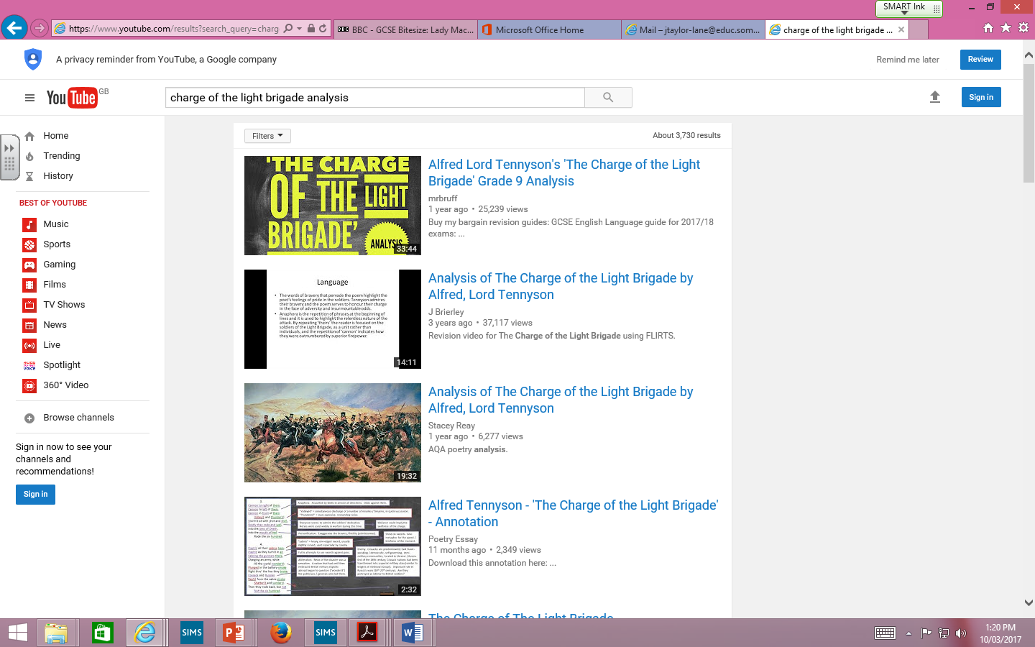

Slide 50
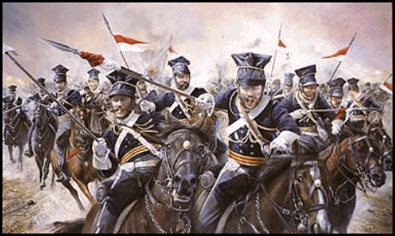
Alfred Tennyson –’ Charge of the Light Brigade.’
CONTEXT
The Crimean War fought between Britain & Russia from 1853-1856.
The most significant moment in the Crimea =Battle of Balaclava.
Order given to the British army's cavalry (the Light Brigade) was misunderstood & 600 cavalrymen charged down a narrow valley straight into fire of Russian cannons. & more than 120 were wounded.
At home news of the disaster was a sensation & a nation that had until then embraced British military exploits began to question the politicians and generals who led them.
FORM - NARRATIVE
EMOTIVE TONE
Tennyson admires the bravery of the Light Brigade. They took orders and sacrificed their lives and the poet believes that this sacrifice should be acknowledged.
Tennyson is also in disbelief and shock at the stupidity of the order but this doesn’t take away from his respect for the soldiers.
Horror – there is a suggestion that the poet is horrified by the violence of the battle
People in awe of the ‘600’ - ‘all the world wonder’d’
THEMES
Obedience
Patriotism
Sacrifice
Heroism
Romance of war
STRUCTURE
3rd person
A strong, regular, relentless rhythm which creates a fast pace, imitating the cavalry charging forward with energy and gusto.
Chronological order.
Some lines are repeated which keeps the focus on the British troops throughout the battle. Repetition creates a sense of impending doom.
The first three stanzas end with the same line giving a sense of foreboding.
Anaphora – ‘Canon’ reinforces their dismal situation – trapped.
Irregular rhyme scheme echoes the chaos of battle
LANGUAGE
‘wonder’d’ the repetition of this word throughout the poem emphasises people’s amazement at their bravery.
The repetition of ‘flash’d’ and the rhyme create a powerful image of them using their swords.
‘Blundered’ hints that the mistake was careless and could’ve been avoided
MEANING
At times ambiguous – celebrating glory of war or questioning those in chage?
The poem seems to be more concerned with creating national heroes for a nation than mourning the dead soldiers or arguing against the war.
IMAGERY/TECHNIQUES
Allusion – ‘Valley of the shadow of Death’ – biblical reference (Psalm 23) shows the significance of the event, God is on the side of the brave?
Alliteration ‘shot and shell’ creates the sound of ammunition firing
Onomatopoeia – sounds from the battlefield.
Metaphors – ‘jaws of death’ gives the reader the idea that death is a creature which the soldiers can’t control or escape from.

Slide 51
Alliteration Enjambment Ode Allusion Parody Full rhyme Assonance Consonance Caesura Narrative Euphemism End stopped line Free verse Imagery Irony Heroic couplet Elegy Juxtaposition Metaphor Iambic pentameter Epic Extended metaphor Onomatopoeia Internal rhyme Ballad
Oxymoron Paradox Repetition Dramatic monologue Personification Refrain Sonnet Simile Symbol Tercet Quatrain Lexical field Pathetic fallacy Trochee/troaich Sibilance Spondee/spondaic Catalexis Stanza Blank verse Hyperbole Tone Rhyme Rhythm
In your exam you will have to be able to comment on the STRUCTURE and FORM of a poem, choices of language and the poet’s use of TECHNIQUE for effect.
Using the list of poetic terms to the left, create a ‘poet tree’ like the one at the back of the room.
Each term must:
Be spelt correctly
Have a definition (use displays, poetry placemats and dictionaries to help)
Must be colour coded correctly GREEN = techniques
ORANGE= form (type of poem)
YELLOW = structural feature
This needs to be finished for prep. It must be neatly presented. You will be tested on some/all of these terms most lessons!

Slide 52
In summary
Re-read texts
Plot timelines x3
Context all 3 texts – posters/flashcards/mind maps
Settings
Character profiles for main characters from all texts
Theme mats
3-5 poems from anthology
Techniques & terminology
How we write to compare

Slide 53
Y11 Raising Achievement in English Language

Slide 54
English Language Paper 1 – 6th June 2017 (40%)
Section A: Responding to unseen 19th century fiction – 1hr
Section B: Creative and imaginative writing - 45 mins
Extract
4 questions increasing in marks (recall (1), inference (2), analysing author’s methods – language, technique & structure (6), evaluate (15))
Choice of 2 writing tasks
Linked to the theme of the extract
Images provided to accompany one question.
40% - GPaS

Slide 55
60 minutes = 24 marks (15%)
6.5 minutes = 1st reading – use strategies for an unseen text.
Q1 – 2.5 minutes
Q2 – 4 minutes
Q3 – 16 (4+12) minutes
Q4 – 30 (5+25) minutes
+25% extra time (+15 mins)
10 minutes = 1st reading – use strategies for an unseen text.
Q1 – 3 minutes
Q2 – 5 minutes
Q3 – 21 (6+15) minutes
Q4 – 36 (6+30) minutes

Slide 56
Over to you…
This is an extract from a short story. The narrator has murdered an old man and hidden his body under the floorboards.
The Tell-Tale Heart: Edgar Allan Poe
I then took up three planks from the flooring of the chamber, and deposited all between the scantlings*. I then replaced the boards so cleverly, so cunningly, that no human eye – not even his – could have detected any thing wrong. There was nothing to wash out – no stain of any kind – no blood-spot whatever. I had been too wary for that. A tub had caught all – ha! ha!
Question 1:
From lines 1 to 5, identify the phrase which explains why there is no blood on the floor. (1 mark)

Slide 57
1 mark
‘A tub had caught all – ha! ha!’
The phrase identified MUST be the one identified in the mark scheme. No marks will be awarded for alternatives.

Slide 58
Over to you…
This is an extract from a short story. The narrator has murdered an old man and hidden his body under the floorboards.
The Tell-Tale Heart: Edgar Allan Poe
I then took up three planks from the flooring of the chamber, and deposited all between the scantlings*. I then replaced the boards so cleverly, so cunningly, that no human eye – not even his – could have detected any thing wrong. There was nothing to wash out – no stain of any kind – no blood-spot whatever. I had been too wary for that. A tub had caught all – ha! ha!
Question 1:
From lines 1 to 5, identify the phrase which explains why there is no blood on the floor. (1 mark)

Slide 59
I had been too wary for that. A tub had caught all.
Marker comment and mark
Although the correct phrase has been given, there are two phrases and the question asks to 'identify the phrase'. The particular phrase is not identified here.

Slide 60
Question 2: From lines 12 to 18, give two ways the narrator’s behaviour shows that he is confident he will not be caught. You may use your own words or quotations from the text. (2 marks)
deputed to search the premises.
I smiled, for what had I to fear? I bade the gentlemen welcome. The shriek, I said, was my own in a dream. The old man, I mentioned, was absent in the country. I took my visitors all over the house. I bade them search – search well. I led them, at length, to his chamber. I showed them his treasures, secure, undisturbed. In the enthusiasm of my confidence, I brought chairs into the room, and desired them here to rest from their fatigues, while I myself, in the wild audacity of my perfect triumph, placed my own seat upon the very

Slide 61
He asks what he has to fear as if the answer is ‘nothing’
He smiles
He welcomes the policemen in
He is able to make up an excuse for the noise
He shows them the whole house
He encourages them to search ‘well’/wherever they want
He shows them the old man’s room/things
His language describes his confidence – ‘enthusiasm in my
confidence’/‘my perfect triumph’
He knowingly puts his seat above the corpse
Saying that the old man ‘was absent from the country’ shows
he is able to make up an excuse

Slide 62
Question 3 – 6 marks
In lines 19 to 24, how does the writer use language and structure to show the change in the narrator’s mood?
Support your views with reference to the text.

Slide 63
In lines 19 to 24, how does the writer use language and structure to show the change in the narrator’s mood?
spot beneath which reposed the corpse of the victim.
The officers were satisfied. My manner had convinced them. I was singularly at ease. They sat, and while I answered cheerily, they chatted of familiar things. But, ere long, I felt myself getting pale and wished them gone. My head ached, and I fancied a ringing in my ears: but still they sat and still chatted. The ringing became more distinct: it continued and became more distinct: I talked more freely to get rid of the feeling: but it continued

Slide 64
In lines 19 to 24, how does the writer use language and structure to show the change in the narrator’s mood?
spot beneath which reposed the corpse of the victim.
The officers were satisfied. My manner had convinced them. I was singularly at ease. They sat, and while I answered cheerily, they chatted of familiar things. But, ere long, I felt myself getting pale and wished them gone. My head ached, and I fancied a ringing in my ears: but still they sat and still chatted. The ringing became more distinct: it continued and became more distinct: I talked more freely to get rid of the feeling: but it continued

Slide 65
Responses may include the following points about the structure of the text:
The use of shorter sentences at the start puts across how the narrator thinks that everything is going to end neatly, but by the end, one long sentence makes up almost half of the paragraph. It puts across his struggle to get rid of the noise
‘it continued’ is repeated to show that the narrator cannot escape the noise
‘but’ is repeated and emphasises the worsening of events
There is a contrast between relaxed police and nervous narrator

Slide 66
At the beginning of the paragraph the narrator is confident - 'I was singularly at ease'. Allan Poe uses short sentences in the piece at the start and middle to convey the narrator's confidence in the circumstances. He uses statements that although related to feelings are presented like facts to show confidence . The use of the word 'But' is the start of the change in the narrator's mood. Allan Poe writes about the nervous symptoms that the narrator is getting and this becomes almost list-like, suggesting the tension is building: 'I felt myself getting pale', 'My head ached' and 'I fancied a ringing in my ears'. The use of the verb 'fancied' also shows that the narrator's nerves are getting to him as he is starting to imagine things happening. Verbs such as 'ached' connote the stress of the narrator. The narrator moves into thinking that what he 'fancied' as a ringing 'became more distinct'. Using the superlative 'more' Allan Poe is able to add to the change in mood he wishes to create. Allan Poe doesn't just use word choice to create an atmosphere. As mentioned before his sentence structure is crucial to his set up towards the crux of the story. At the end of this particular paragraph then sentences have become considerably and noticeably longer to those at the beginning. The longer sentences are constructed through the use of colons, hyphens and embedded clauses. Using this punctuation the writer has been able to include large amounts of information in a single sentence, showing a stream of consciousness. This results in a hectic - almost dizzying - finish to the paragraph as the narrator's mind becomes confused and taken over by paranoia.

Slide 67
Analysing language
Analysing structure
If you find techniques difficult, after establishing the focus of the question, pull out individual words and explain their effect.
How does the language sound – formal? Informal (colloquial)? Conversational? Dramatic? Ironic? etc..
Look for patterns (lexical fields)
The structure of a text can refer to:
The ordering of the events and particular techniques being used such as flash back or flash forward to draw the reader’s attention to a particular point in time first/chronological order.
The ordering of ideas
The use of different elements, such as bullet points or dialogue, headings or subheadings (NF)
Withholding information until a later point to shock or interest the reader
BASIC | GOOD | IMPRESSIVE
Noun – common, proper, collective, abstract Adjectives – comparative & superlatives Verbs Adverbs Pronouns Conjunctions/connectives Prepositions Determiners Interjections Imperatives | Atmosphere Climax Cliché Conflict Characterisation Dramatic irony Emotive language Foreshadowing Hyperbole Imagery Metaphor Onomatopoeia Oxymoron Pathetic fallacy Personification Repetition Rhetorical quesiton Simile Triplet Sibilance | Analogy Allegory Allusion Anthropomorphism Assonance Consonance Euphony Idiom Irony Juxtaposition Lexical field Motif Extended metaphor Paradox Parallelism Poetic justice Pun Symbolism Sarcasm Surrealism
Annotating structure
Look at the overall text to begin your annotation. Can you spot patterns in the structure? Look out for:
  paragraph lengths
  repeated words introducing paragraphs
  signpost sentences introducing paragraphs (like 'Firstly...', 'Secondly...', 'In addition...')
  headings and subheadings
  time and place
BASIC | GOOD | IMPRESSIVE
Order of events (how it builds up) – exposition, conflict, climax & resolution (fiction) Narrative voice (1st, 2nd, 3rd) Punctuation – dramatic pauses? Fast paced/slow paced? | Repetition Triplets Lists Dialogue Themes | Type of sentence (one word, simple, complex, compound, minor) Syntax Semantics

Slide 68
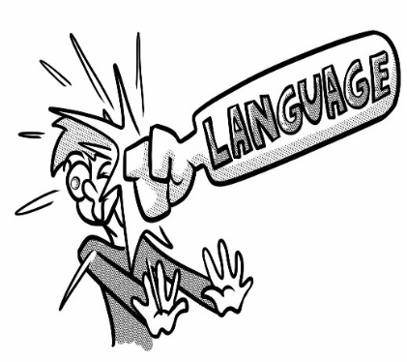
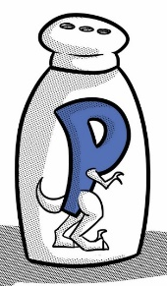
AVOID THE VAGUE PITFALL:
It makes it stand out
It makes me want to read on
It is a really interesting way of putting it
The way the writer described it was amazing!
This makes the story more realistic and
brings it back to reality
This gets the reader thinking
AVOID THE FLOWERY PITFALL:
The image it creates in your head just captivates the reader and transports them to another world.
This writer creates to the reader a sad, light-hearted idea of how cold he must be and many people who may get into the story may want to help him.
The writer uses _______________________ to make the reader:
Think
Feel
Understand
Sympathise
Be angry
Imagine
Empathise
Be excited about
Be intrigued about
Evaluative Phrases
These are some of the types of phrases that you can use:
Paints a picture of
Makes simple use of
Makes striking use of
Cleverly expresses the idea that
The image created is dramatic
Crafts a sense of
Makes apt use of
Skillfully shows
Here is a suggested way to memorise them before your exam:
The PAINTer draws a SIMPLE picture of a dinosaur STRIKING a CLEVER man. The image is DRAMATIC as we witness the CRAFTy rAPTor’s* SKILL for hunting prey.
Note the dinosaur on the image
as an extra way to remember this!
X

Slide 69
Analysing the effect…
Verbs such as 'ached' connote the stress of the narrator.
Verbs such as 'ached' connote that he ached.

Slide 70
Success in question 3
Make sure you take time to understand the question.
Read the stated lines with a purpose – annotate the extract as you read.
PQA
Language AND structure
Use correct terminology to refer to features of language and structure.
Analyse the effect
1 page

Slide 71
Question 4 – 15 marks
In this extract, there is an attempt to build tension. Evaluate how successfully this is achieved.
Support your views with detailed reference to the text.

Slide 72



Evaluate

Slide 73
Question 4 Success criteria
30 minutes (5+25)
Read question carefully – make sure you have identified the focus e.g. to ‘build tension’
Work through the text chronologically – knowledge of whole text.
Content, language AND structure
Terminology – adjectives, similes, triplets etc.
Effect, effect, effect!! NOT ‘it makes the reader want to read on’ or ‘it makes it flow’ BE SPECIFIC – THINK CONNOTATIONS!! Why is it successful/not successful?
Want to get over half marks? Aim for 1.5-2 sides!
YOU MUST MAKE A JUDGEMENT!!

Slide 74
The theme of the extract is hiding a secret and the guilt that this can lead to. Because of this the tension is developed through the piece, and very quickly builds up in a short space of time. The idea of a secret is shown at the start of the extract and the way that this is described by the writer develops tension. The language used avoids description of whatever is being hidden, and because of this the reader feels a sense of intrigue initially. He writes 'deposited all between the scantlings', but 'all' is not specific. The use of the narrator's reflection on how well he has done to hide the item moves the reader from intrigue to concern. Because he uses the adverbs 'cleverly' and 'cunningly' the reader is manipulated into thinking that he is deliberately trying to conceal the item from someone else. The confirmation of the idea that something is wrong is seen in the use of 'wrong' at the end of the sentence. At this point the reader's tension has been built through the themes of intrigue and concern about what he has done. The language to describe what is not visible, the blood, shows us that whatever is hidden is something that was alive, and this confirms the suspicions we had.

Slide 75
In the next section the narrator is telling us what the police say happened so the reader's tension is built. We are drawn into the idea that something could have happened and the evidence that is presented - a 'shriek had been heard by a neighbour', 'suspicion of foul play had been aroused', 'information had been lodged'. This evidence set against the evidence suggested in the previous paragraph effectively build tension by contrasting the ideas - the reader is led to wonder if what has been hidden is related to the possible incident that the police are investigating. The narrator has hinted that it is by saying 'for what had I now to fear?' The question in itself makes the reader tense, as they know that there is something to fear because of the blood and hidden item.
In the next section the narrator's risky behaviour creates tension as the narrator tells us that he decides to almost show off what he has done - 'I bade them search - search well', 'I brought chairs into the room...placed my own seat upon the very spot beneath which reposed the corpse of the victim.' This behaviour creates divided emotions in the reader ' thinking that he is mad to take such risks as he is going to be caught by showing off and hoping that he will be caught. This division is tense and creates suspense very cleverly.

Slide 76
In the next sections the narrator's thoughts and feelings begin to dominate rather than his actions. This builds tension as the reader becomes more aware of how he is feeling through his physical symptoms - 'My head ached, and I fancied a ringing in my ears'. We then experience the tension with him as he starts to feel unwell. From this point the focus is very much on the narrator's thoughts and feelings, rather than what the police are doing. This increases the tension as the reader is aware that it is not the police investigation that could incriminate him but he own behaviour as they 'chatted of familiar things' and cannot hear the noise he hears. The contrast between his behaviour and the police's behaviour becomes even more evident as his mental state deteriorates as he 'talked more quickly - more vehemently', 'argued about trifles, in a high key and with violent gesticulations'.
The tension reaches its climax in the structure and language used by the narrator to show his feelings of guilt and paranoia. There are repeated exclamations and the verbs used to show what he does build tension by showing extreme actions 'I foamed! - I raved - I swore!' The pace becomes much quicker here due to the language and structure and this build tension because the reader feels things are moving very quickly. The contrast between the ideas of what he thinks the police are doing - 'They heard! - they suspected - they knew!' - and what they are actually doing - 'chatted pleasantly, and smiled' - demonstrates to the reader his complete breakdown, creating a sense in the reader that he will be caught. The tension is brought to a final climax as the reader realises that he cannot continue with what he has done and must confess, which he finally does.

Slide 77
To be successful in section A
Spend time reading and re-reading the questions – underline key words and phrases.
Take your answers from the stated lines only.
Double check the answer you have is the most relevant.
Question 3 = language AND structure, use correct terminology to refer to features of language and structure.
MUST analyse EFFECT – DON’T be generic e.g. it makes you want to read on…
Question 3 & 4 = annotate the extract, write PQA
Question 4 = evaluate (how well)

Slide 78
SECTION B: CREATIVE/IMAGINATIVE WRITING
Choice of two writing tasks:
TOP TIP – DON’T ATTEMPT THE NARRATIVE TASK!

Slide 79
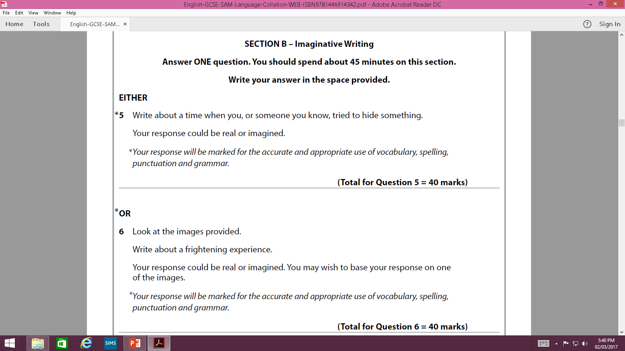

Slide 81
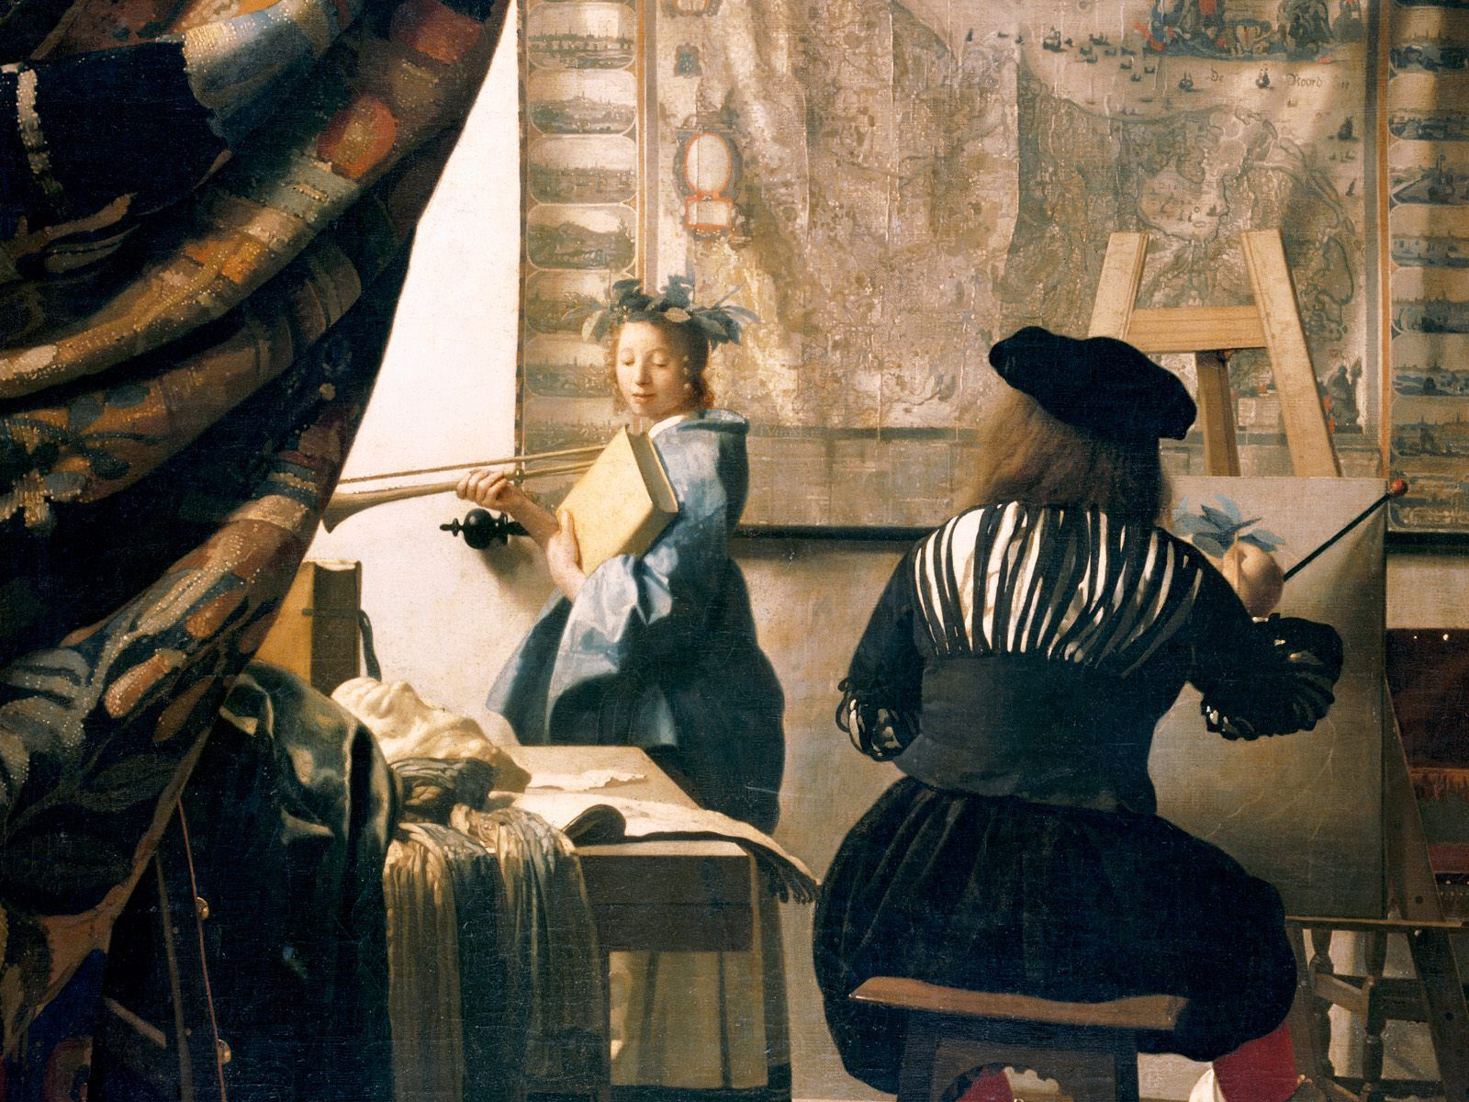
Descriptive writing
To paint a multi-sensory and vivid picture of a person, place, feeling or event

Slide 82

How they should spend their time?
1 minute selecting question and identifying the topic/theme
5 minutes planning.
34 minutes writing.
5 minutes proof reading and editing.

Slide 83
10 top tips for brilliant descriptive writing…
Try to write about what you know – close your eyes and picture it!
Appeal to the senses – sight, smell, taste, touch & sound
Use interesting words (especially verbs, adjectives and adverbs) and literary devices e.g. metaphor, personification etc.
Write a lot about a little – zoom in like a camera – different aspects for different paragraphs
Vary the start of your sentences.
Write in the 3rd person.
Don’t use dialogue.
Vary your sentence structure – one word, simple, minor, compound, complex.
Use objects to convey an atmosphere/mood/feeling
Avoid clichés e.g. her hair shone like the sun.

Slide 84
2) What senses have been used?
The old man’s face was a map of creases and lines which ran backward and forwards across his features. He was mumbling to himself as he staggered forward unsteadily. Subtly at first, then becoming increasingly overwhelming, the acrid stench of stale tobacco wafted from his stained jacket.

Slide 85
3) Don’t walk when you can:
Stroll, saunter, amble, wend one's way, trudge, plod, hike, tramp, trek, march, stride, troop, patrol, step out, wander, ramble, tread, prowl, footslog, promenade, roam, traipse, stretch one's legs, go for a walk, take the air; advance, proceed, move, go, make one's way; mosey, pootle, yomp, perambulate.

Slide 86
3) KNOW YOUR DEVICES/TECHNIQUES!
Exaggerated language
A comparison using like or as.
A word that describes a noun.
Language that uses the 5 senses.
Comparing one thing directly to another.
A word that describes a doing word.
Giving something human characteristics
Repetition of the same letter at the beginning of a string of words.
A word that makes the sound it describes
Repetition of an ‘s’ or ‘sh’ sound.
Adjective
Adverb
Alliteration
Sibilance
Onomatopoeia
Personification
Metaphor
Imagery
Hyperbole
Simile

Slide 87
4) A little about a lot…what am I describing?
A curtain of mist enveloped us, swallowing the innocent vessel. Dancing droplets illuminated by powerful reaching tendrils of sunlight caused an explosion of light and colour. Angrily the turquoise waters churned below, brutally bashing against us; the spray a tirade of anger.

Slide 88
5) How can I start my sentences?
Vary the start of your sentences using different parts of speech
Verbs
Adverbs
Adjectives
Prepositions
Connectives
Interjections
Pronouns
Determiners

Slide 89
6) 3rd!!
He, him, his
She, her, hers
it, its
they
them
their/theirs
Harry/Sally

Slide 90
7) No dialogue
Suddenly Harry exclaimed, “ouch!” Then Sally said,
“what have you done?”
DON’T turn it into a story with dialogue – paint a picture with your words.

Slide 91
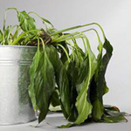
9) How do objects send messages?
CREATE SYMBOLISM
DEATH

Slide 92
What objects could you use to convey…
Freedom
Fear
Isolation
rage

Slide 93
structure
Aim for 2 sides
A striking opening
Controlled paragraphs
Variation of sentence length
Plan 5 paragraphs using the ‘zoom’ principle.

Slide 94
Describe a memorable room
bookcase
Painting on chimney breast
Childhood living room
sunlight
dust
protective
curtains
Brown - mahogany
Velvet – thick, sumptuous
fireplace

Slide 95
Sequence ideas into a paragraph
Silently the room slept, an island of tranquillity temporarily adrift from the hustle and bustle of family life. Sumptuous, thick, heavy, mahogany brown, velvet curtains were pulled across the large patio doors; a protective barrier from the harsh heat of the oppressive July afternoon sun. Aggressively a lone beam of sunlight punched its way through a narrow gap between the curtains. Its long reaching arm softly illuminated small particles of dust dancing lazily, drifting aimlessly.

Slide 96
The heart of the room on the opposite wall was lit up like a character in a play as the spotlight landed upon it. Dormant since the spring, it still emitted a faint smoky aroma - one that evokes a sense of safety, contentment and belonging. The well-worn hearth bore the scars of generations of use; the abundance of singed, round holes on the carpet in front - memories etched in the very fabric of the room. Cold and grey, the rack of four toasting forks hung, waiting for the autumn, waiting for the bread, the marshmallows, the sausages and chestnuts; waiting to be warmed once again by the friendly crackle of a roaring fire and the touch of a warm hand eager for their treat of the evening.
Proudly the chimney breast puffed out its chest to display the centre-piece of the room; a beautifully detailed watercolour of the ‘cut’ outside: a snap shot of the view currently concealed by the drawn curtains. Soft, delicate yet purposeful brushstrokes capture the warm dappled pattern of light penetrating the green and yellow trees and flickering upon the muddy brown surface of the canal. Exquisite detail: a water boatman skating across the surface, the indentation upon the water’s surface visible on closer inspection; a swan gliding regally, majestically in front of her signets. The tranquillity in paint a window to the reality outside.

Slide 97
Ultimately - show don’t tell
NOT – He was angry.
Trembling, his eyes darted about the room. He could feel the thunder of his straining heart as it sought desperately for a way to break out of his heaving chest.

Slide 98
English Language Paper 2 – 12th June 2017 (60%)
Section A: Responding to unseen 20th/21st century non-fiction– 1hr 15 minutes
Section B: Transactional writing 45 mins
2x unseen extracts
3 questions on each + 2 on both:
  Recall
  Inference
  Analysis
  Evaluation
  Synthesise
  Compare and contrast
Choice of 2 writing tasks
40% - GPaS
  PAF

Slide 99
75 minutes = 1.4 (1.7+25%) minutes per mark
1= 2.5 minutes
2= 2.5 minutes
3= 20 minutes (5+15)
4= 1.5 minutes
5= 1.5 minutes
6= 20 minutes (5+15)
7a= 9 minutes
7b = 18 minutes
1= 3 minutes
2= 3 minutes
3= 25 minutes (5+20)
4= 2 minutes
5= 2 minutes
6= 25 minutes (5+20)
7a= 10 minutes
7b = 24 minutes

Slide 100
SKILLS
Q | SKILL
1 | Identify (1 mark)
2 | Explain & analyse (2 marks)
3 | Explain & analyse (methods – language, structure, techniques) (15 marks)
4 | Identify (1 mark)
5 | Explain & analyse (1 mark)
6 | Evaluate & judge (methods – language, structure, techniques) how successful? (15 marks)
7a | Compare & synthesise (6 marks)
7b | Compare (14 marks)

Slide 101
Question 1&4
Accept any reasonable answer based on designated lines up to a maximum of 2 marks.
Quotations and candidate’s own words are acceptable.

Slide 102
Q2 - Give one example from lines 1 to 8 of how the writer uses language to show how the recruitment process has changed.
Support your example with a detailed text reference.
Recruiting for HM Secret Intelligence Service used to be a subtle, stylish business. One afternoon in term time, a promising undergraduate at Oxford or Cambridge would find himself invited to tea with the college talent spotter. In the quiet of an oak-panelled study, the potential recruit (right school, right family) would be subjected to gentle interrogation over crumpets, before being asked (clink of spoon on china) if he had ever considered ‘official work’. If the encounter proved satisfactory, the candidate received a letter inviting him to an interview. Fast–forward three years and there is our man in a crumpled linen suit, sitting in a Lisbon café sizing up…

Slide 103
Question 2&5
Award 1 mark for a valid example from stated lines, and 1 mark for the text reference.
Do NOT accept an example without a text reference.
QUOTE + EXPLANATION

Slide 104
Question 3 – 15 marks
Analyse how the writer uses language and structure to interest and engage readers.
Support your views with detailed reference to the text.

Slide 105
Question 3 – success criteria
3= 20 minutes (5+15)
Read question carefully – make sure you have identified the focus e.g. to ‘interest and engage’
Work through article chronologically – knowledge of whole text - ANNOTATE
Language AND structure
Terminology – adjectives, similes, triplets etc.
Effect, effect, effect!! NOT ‘it makes the reader want to read on’ or ‘it makes it flow’ BE SPECIFIC – THINK CONNOTATIONS!!
Want to get over half marks? Aim for 1.5-2 sides!

Slide 106
Question 6 – 15 marks

Slide 107
Question 6 Success criteria
20 minutes (5+15)
Read question carefully – make sure you have identified the focus e.g. to ‘build tension’
Work through the text chronologically – knowledge of whole text.
Content, language AND structure
Terminology – adjectives, similes, triplets etc.
Effect, effect, effect!! NOT ‘it makes the reader want to read on’ or ‘it makes it flow’ BE SPECIFIC – THINK CONNOTATIONS!! Why is it successful/not successful?
Want to get over half marks? Aim for 1.5-2 sides!
YOU MUST MAKE A JUDGEMENT!!

Slide 108
Question 7a (6 marks)
The two texts show the points of view of different spies. What similarities do the spies Nick and Leo share in these texts?
Use evidence from both texts to support your answer.

Slide 109
Question 7a – mark scheme
LIMITED
SOUND
DETAILED

Slide 110
Question 7b
Compare how the writers of Text 1 and Text 2 present their ideas and perspectives about intelligence agency work.
Support your answer with detailed reference to the texts.

Slide 111
What they’re looking for?
Comparisons
How language, structure and techniques reveal the author’s perspectives.
Use of quotations

Slide 112
How to approach it?
Plan first!

Slide 113
 | Bryson | Gormon
Purpose, Audience, Format | Entertain/inform, journal, middle class, travellers/retired | Entertain/inform, journal, middle class, travellers/retired
Content | The growth of the American diner | Story of one diner/end of an era
Language | Sophisticated/factual “luncheon” Informs about slang Humorous “washiteria” Sarcastic | Emotive language Descriptive Humorous
Structure | Chronological Lists | Narrative tone – recount of his personal experience Lists dialogue
Techniques – | Irony | Metaphor – “ring master” Simile “was like a spinning radio dial”

Slide 114
Transactional writing (paper 2)
Skill
How can I improve?
Using language, structure and techniques to achieve a deliberate effect.
SPaG
Practise identifying the PAF of questions.
Know the features of the triplets:
  Persuade/argue/advise
  Inform/explain/describe
  Analyse/comment/review
  Know the features of different FORMATS of writing
  Learn sensible farmers…
  Learn HADAFORREST techniques

Slide 115
The form may be:
An article
A letter
A speech
Review
report
Texts for a leaflet
A blog
An internet page
A radio script
Notes:
- What is the success criteria?
-

Slide 116
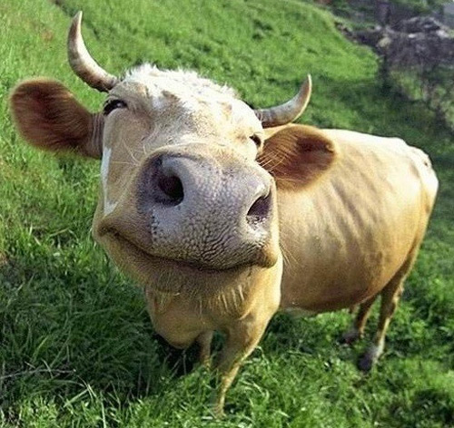
THE ARGUMENT PLAN
1. Snappy opening – ( shock tactic, rhetorical question…)
2. FACTS & STATS – what are the issues, facts about topic (make it up – dates % etc)
3. My opinion
4. The benefits (how the reader benefits)
5. The negatives (consequences for reader)
6. Quotes from trustworthy people
7. Anecdote
8. Counterargument (you may think…
I know you will say…but…)
9. Imagine a world……
10. What happens next?
Sensible
Farmers
Own
Beef
Not
Quorn
And
Can’t
Imagine a world
Without it

Slide 117

How to remember all of these?
Technique
1. Hyperbole (exaggeration)
2. Anecdote (real examples)
2. Direct Address (2nd Person)/directives (imperatives – Listen!)
3. Adjectives/adverbs/ alliteration
4. Flattery (praising/giving compliments
5. Opinions/opinions of experts
6. Rhetorical Question
7. Repetition
8.Emotive language/ Imagery (simile, metaphor etc)
9. Statistics
10. Standout Punctuation/short sentences – Underlining, Capitalization, Exclamation Marks/short
11. Triplet
H
A
D
A
F
O
R
R
E
S
T

Slide 118
AO5 – content & organisation |  |  | AO6 -Accuracy
 | Mark | descriptor |  | Mark | descriptor
1 | 1-4 | Basic Not a clear understanding of audience or purpose Limited use of structural features | 1 | 1-3 | Basic vocabulary, frequent spelling errors Punctuation used with basic control (full stops & capital letters). Sentence structure likely to be repetitive.
2 | 5-9 | Straightforward Awareness of purpose and audience. Paragraphs used clearly, range of other structural devices used. | 2 | 4-6 | Range of correctly spelt vocabulary Punctuation used with control creating a range of sentence structures (simple, complex, compound, embedded, minor, one word)
3 | 10-14 | Selection of language and techniques to suit audience and purpose. Ideas are developed and linked. | 3 | 7-9 | Varied vocabulary and words with irregular patterns are spelt correctly. Accurate and varied punctuation
4 | 15-19 | Language and devices are chosen for a particular effect. Information is managed and structural features are used deliberately and cohesively throughout the text | 4 | 10-12 | Wide & selective vocabulary with only occasional spelling errors. Range of punctuation to create a deliberate effect.
5 | 20-24 | Subtle and sophisticated use of language and techniques Manipulates complex ideas using a range of structural features. | 5 | 13-16 | Extensive vocabulary used strategically, spelling errors are rare. Punctuation is accurate and precise. Sentences used to create deliberate effects.

Slide 119
In summary
Read
Learn language & structural features
Practise annotating
Learn analytical & evaluative phrases
Edexcel intervention books for reading and writing
SPaG workbook
Learn descriptive techniques & top 10 tips for creative writing
Learn Sensible Farmers Own Quorn and Can’t Imagine a world Without it.
Lead HADAFORRREST
Learn features of the writing triplets
Learn the features of different formats of writing

Slide 120
They need…
To collect their folders
Ensure that they have their copies of the 3 texts and their anthologies
Ensure they have their revision guides
SPaG guide/workbook (CGP)

Slide 121
Revision packs
Raising achievement PowerPoint
Edexcel Reading intervention workbook
Edexcel Writing intervention workbook
Sample papers for Literature 1&2 (complete towards end of holiday after revision)
Poetry revision notes
Comprehension questions for each of the 3 set texts

Slide 122
Questions?
Vdavis@educ.somerset.gov.uk
Mcraig@educ.somerset.gov.uk

