Slide 1
Y11 Raising Achievement in English 2020

Slide 2
1-9 GCSE English Literature & Language - Edexcel
English Literature
Paper 1 (Macbeth & Blood Brothers): Wednesday 13th May
Paper 2 (Jekyll & Hyde &poetry): Thursday 21st May
Paper 1 (unseen 19th century fiction & creative writing): Tuesday 2nd June
Paper 2 (comparing unseen 20th&21st century non fiction & transactional writing): Friday 5th June

Slide 3
Y11 Raising Achievement in English Literature

Slide 4
English Literature Paper 1 – 13th May 2020 (50%)
Section A: Macbeth 55 minutes
Section B: Blood Brothers 50 minutes
1 extract from anywhere in the play – ‘How’ question.
1 question knowledge of whole play (likely thematic)
Choice of 2 questions
Character
Setting
Theme
techniques
20% - GPaS

Slide 5
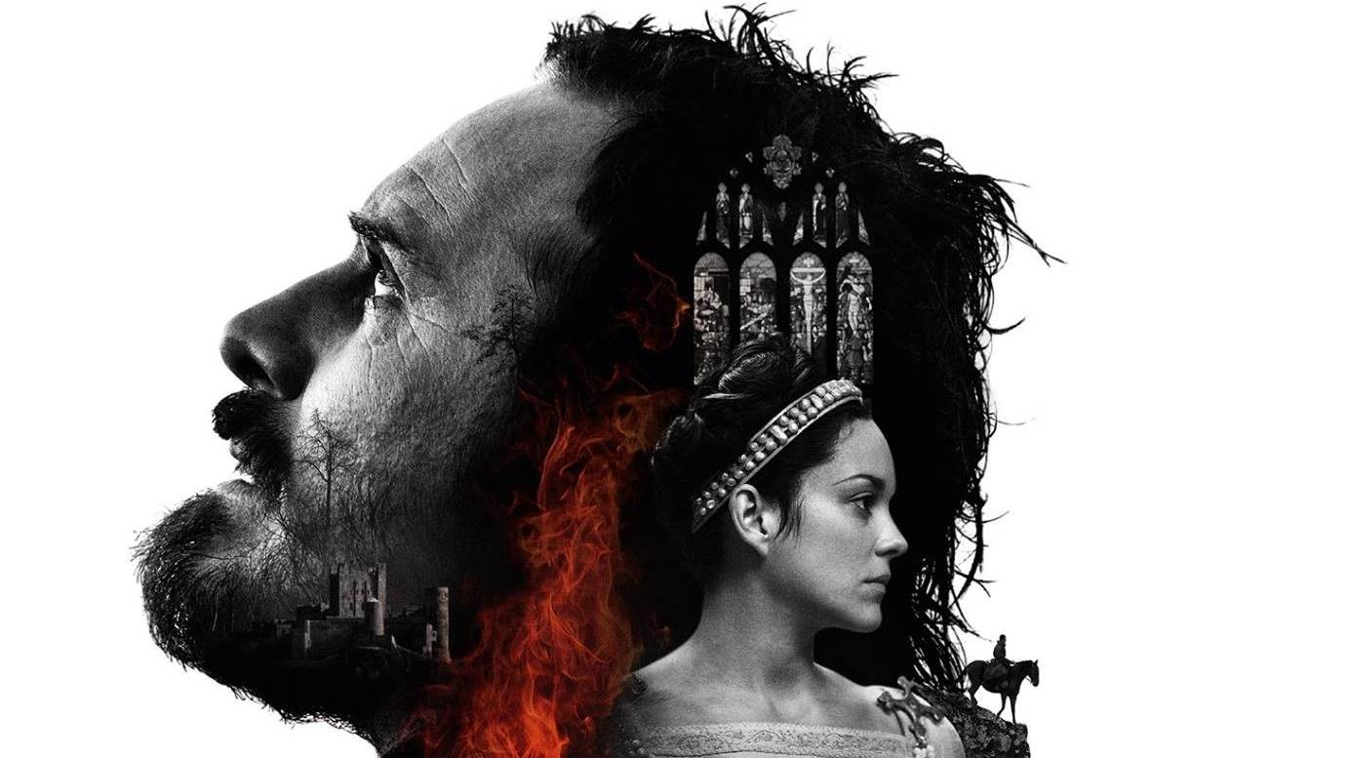
Section A – ‘Macbeth’

Slide 6
Question A
Extract based
20 marks
27.5 minutes
1 minute unpicking question and making sure you understand the focus.
6.5 minutes reading extract and annotating – identifying language, techniques and structure – effect & link to question
20 minutes writing – 2 pages

Slide 7
Only 2 criteria
Ability to ANALYSE the effect of language, structure and techniques
Ability to use correct terminology

Slide 8
How does Shakespeare use language to show the changing relationship between Macbeth and Banquo? (20)
Language, structure, techniques?
‘Thou hast it now: king, Cawdor, Glamis, all,
As the weird women promised, and, yet I fear,
Thou play’dst most foully for it

Slide 9
Language, structure, techniques?
Soliloquy – Banquo no longer trusts Macbeth enough to discuss his true feelings
Triplet – makes Macbeth seem powerful. Banquo realises that the witches are a dark, evil force to be taken seriously.
‘play’dst’ - Banquo is hinting that Macbeth doesn’t appreciate the severity of his actions. He is treating it like a game he doesn’t want to lose.
‘Thou hast it now: king, Cawdor, Glamis, all,
As the weird women promised, and, yet I fear,
Thou play’dst most foully for it
Repetition of ‘Thou’ implies Banquo is accusing Macbeth – he no longer trusts him
‘foully’ reminiscent of the language used by the witches – Banquo fears the influence they have over Macbeth
‘Fear’ suggests Banquo is scared of Macbeth’s capabilities – probably justifiably so given his record in battle

Slide 10
Language
Type of language? | Word class
Archaic Chatty Colloquial Comical Complicated Conversational Declamatory Descriptive Dramatic Economical Eloquent Emotive Emphatic Exaggerated Factual Figurative Formal Graphic Humorous Idiomatic Incoherent Inflammatory Informal Literary Lyrical Native Ornate Poetic Punchy Rambling Scientific Simple Sophisticated Subject specific Succinct Technical Turgid Vague Verbose | Noun – common, proper, collective, abstract Adjectives – comparative & superlatives Verbs Adverbs Pronouns Conjunctions/ connectives Prepositions Determiners Interjections Imperatives
What to look for when analysing a text? LANGUAGE, STRUCTURE & TECHNIQUES (SLT)
Structure | How the text is constructed (put together)
Language | What type of words are used?
Techniques | What literary or rhetorical devices are used?
‘How does the author…..?’
HOW = METHODS!
H
O
W
T
O
A
N
A
L
Y
S
E
Structural features
Basic | Good | Impressive
Order of events (how it builds up) –exposition, conflict, climax & resolution (fiction) Narrative voice (1st, 2nd, 3rd) Punctuation – dramatic pauses? Fast paced/slow paced? Paragraphs | Repetition Triplets Lists Dialogue Themes Foreshadowing Juxtaposition Precursor Topic sentence Discourse markers | Catalyst Denouement Type of sentence (one word, simple, complex, compound, minor) Syntax Semantics

Slide 11
Annotate | label, add notes to
Denotation | The literal or primary meaning of a word
Connotation | The implied or associated meanings. What it suggests to you.
Language
Structure
Techniques
Layers of meaning
Author’s purpose
Context
How to analyse a text: step by step:
Make sure you understand what purpose you are being asked to analyse for e.g. ‘How does the writer create tension?’ = You are on the look out for ways the writer creates tension.
Highlight anything that you think is relevant.
Go back and look at what you have highlighted.
Can you identify any terminology (the correct name for a devise. E.g. a comparison using ‘like’ or ‘as’ is a simile. Whatever you find annotate your text.
Look at what you’ve highlighted you need to think about the EFFECT it has had on you as a reader. In other words what does it make you:
Think
Imagine
Feel
Annotate with your interpretations!
Techniques
Good | Impressive
Anecdote Alliteration Atmosphere Climax Cliché Conflict Characterisation Dramatic irony Directives/direct address Emotive language Foreshadowing Hyperbole Imagery Metaphor Onomatopoeia Oxymoron Pathetic fallacy Personification Repetition Rhetorical question Simile Triplet Sibilance | Analogy Allegory Allusion Anthropomorphism Assonance Consonance Euphemism Euphony Idiom Irony Juxtaposition Lexical field Motif Extended metaphor Paradox Parallelism Poetic justice Pun Symbolism Sarcasm Surrealism
H
O
W
T
O
A
N
A
L
Y
S
E

Slide 12
Section A checklist (reading)
Understand focus of question
Read with a purpose -ANNOTATE
Identify 3-5 quotes (depending on scope for analysis.)
Annotate your selected quotes on your extract:
Connotations of words/relevance/cross-reference?
Techniques – effect?
Structural features – effect?

Slide 13
How to answer a ‘how’ question
Where?
Language Paper 2 – Q3
Lit Paper 1 – ‘Macbeth’ A
Lit Paper 2 - Jekyll & Hyde A.
Read the question – identify the focus – how the writer creates mystery, fear, suspense, drama tension etc..
Read blub – what important information can you learn?
Read once for understanding – pen in hand summary sentences as you go
Read again – aim to pull out at least 5 quotes – remember you must talk about language structure and techniques – try and label S, L or T
Label with the correct terminology and the effect it creates
1.5-2 pages
‘HOW’ question success criteria | Y | N
You have talked about the author’s choice of language
You have discussed structure
You have discussed techniques
You have used subject terminology where you can
You have written in PQA paragraphs
You have not used the word ‘quote’ in your answer
You have discussed at least 3 key quotes
You have used single word analysis where I can
You have offered multiple interpretations where you can
You have commented on authorial purpose in your analysis
You have varied your language for analysis
You have used model verbs and modifiers to show a sense of certainty or uncertainty.
Your answer is developed and you have discussed at least 5 key quotes
You have embedded your quotes
You answer is clear and makes sense (proof read)
Your answer is concise (no waffle! ‘cut and shunt’
Paragraph
Structure | One way the writer engages the reader is by using (insert METHOD e.g. well chosen adjectives, a simile, violent verbs etc.) For example, “……….” This suggests……..The word “………” creates. Make sure you link back to the focus of the question.
Language
Techniques

Slide 14
Grade 7, 8 & 9
The response is a cohesive evaluation of the interrelationship of language, form and structure and their effect on the reader.
Relevant subject terminology is integrated and precise.

Slide 15
From the extract we learn that Banquo no longer trusts Macbeth as he delivers his true thoughts and feelings about recent events to the audience through a soliloquy. Banquo’s use of the second person and repetition of ‘Thou’ makes his tone seem accusatory, again signifying that he no longer trusts his former friend and confidant. The use of the triplet, ‘king, Cawdor, Glamis’ makes Macbeth seem powerful and possibly intimidating to Banquo; it also reinforces the idea that the witches are a dark and evil force to be taken seriously. Shakespeare’s choice of language for Banquo is also revealing about how he feels about Macbeth. For example, the abstract noun ‘fear’ suggests Banquo is scared of Macbeth’s capabilities – probably justifiably so given his record in battle. Furthermore, the adverb ‘foully’ is reminiscent of the language used by the witches suggesting that Banquo fears the influence they have over Macbeth. Lastly, by using the verb ‘play’dst,’ Banquo (Shakespeare) is hinting that Macbeth doesn’t appreciate the severity of his actions. He is treating it like a game he doesn’t want to lose.

Slide 16
Sample Question B
In the extract we see Banquo being ‘disloyal’ to Macbeth. Explore the significance of loyalty elsewhere in the play. (20)

Slide 17
Question B
Tests knowledge of whole play
Thematic/character/setting/techniques e.g. symbolism
20 marks
27.5 minutes
1 minute unpicking question and making sure you understand the focus.
6.5 minutes planning – key points, quotes & context
20 minutes writing – 2 pages

Slide 18
A theme is not examples…
A theme is what the author/poet/playwright want us to understand about that theme (idea)
The play is a construct and was written to convey certain ideas and messages that would have been relevant to a contemporary audience – you have to understand what themes are!
Ingredients of a theme question:
Key examples of theme
Analysis of quotes linked to theme
Relevant contextual knowledge
Key ideas about theme

Slide 19
Success criteria:
CANNOT talk about the extract
MUST have a relevant personal response (don’t just re-tell events)
Must be developed
Focussed to the question
Use references/quotes from the play
Show an understanding of author’s purpose/intent
Link to social & historical context

Slide 20
Where else in the play do we see loyalty?
Act 1 scene 4
Act 1 scene 5
Act 2 scene 2
Act 3 scene 1
Act 3 scene 3
Act 4 scene 2
X

Slide 21
Understand the focus and plan!
Where?
Act 1 scene 4
Message:
Treason is wrong and a sin
What is happening?
Duncan has just announced his heir – Malcolm to be Prince of Cumberland. M’s loyalty starts to waiver
Loyalty
Context:
suggestion of treason = shocking. Audience have recent knowledge of how the crown deals with traitors. ‘Divine Right of Kings.
Analysis:
Juxtaposition
Symbolism
Alliteration
metaphor
Quote/s
“stars hide my fires, let not light see my deep and dark desires”
“that is a step which I must o’leap”
You can focus on ONE example in detail or multiple examples BUT you must be able to do the above for each example

Slide 22
How to structure a Band 3+ theme answer
1 | Another place we see the theme of loyalty and betrayal in the play is where…….
2 | For example, ‘…………………………….’ + analysis
3 | At the time,…………….(context)
4 | Ultimately Shakespeare wants his audience to understand that…..

Slide 23
Another place we see the theme of loyalty and betrayal in the play is in Act 1 scene 4. In this scene Duncan names Malcolm as Prince of Cumberland and heir to the throne of Scotland. Up until this point Macbeth has been presented as a loyal and brave subject, fighting for his king against foreign and domestic threats. In this scene we see Macbeth’s loyalty begin to waiver for the first time and see signs of his future betrayal. For example, after hearing Duncan’s proclamation Macbeth says, “stars hide my fires, let not light see my deep and dark desires.” The use of metaphor ‘fires’ for Macbeth’s ambition suggests the extent of his desire; it creates tension as we all know what happens to a fire which is left to burn unchecked. Shakespeare also juxtaposes ‘light’ and ‘dark’ this could represent Macbeth’s internal conflict between what he knows is right and his own ambition. The alliterative use of ‘d’ creates a sinister sound; this percussive sound could be a subtle use of foreshadowing, heralding the arrival of a new king. At the time, social climbing was a pre-occupation for all those who attended the British court with all vying for position, wealth and royal favour. Macbeth’s ambition itself would not have been shocking to a contemporary Jacobean audience. What would have been shocking was the extent of his ambition. In the seventeenth century even considering the death of a monarch was considered treason. It completely defied the belief of the ‘Divine Right of Kings’ which declared that the king was God’s representative on earth: betraying your king was betraying God and therefore you risked not only a gruesome end on earth, but the eternal damnation of your soul. The scene gets more shocking when Macbeth says “that is a step which I must o’er leap.” This implies that not only is he contemplating deposing one monarch but potentially two. The use of the metaphor ’step’ is a reminder to the audience of Macbeth’s ambition to climb in society. It also dehumanises Malcolm again suggesting Macbeth finds his own thoughts shocking. Ultimately Shakespeare wants his audience to understand that betraying you monarch is shocking and an unspeakable act of treason.

Slide 24
Shakespeare’s messages
Good will always overcome
God is on the side of the virtuous
Nature will always find a way to right itself
It is wrong to commit treason
Treason will always be punished
Treason is a crime against God for which you risk your immortal soul
Women are easily seduced by the supernatural?
Women do not belong outside of their ‘natural sphere of influence’?
Women are manipulators?
The supernatural is dangerous
Ambition, unchecked, is dangerous
The new king is all powerful and should be respected
Our sins will always be punished
The higher you reach the greater your fall
Be careful where you place your trust – appearances can be deceiving

Slide 25
Question B – to get 4+
CANNOT talk about the extract
MUST have a relevant personal response (don’t just re-tell events) – USE WRITING FRAME!
Must be developed
Focussed to the question
Use references/quotes from the play
Show an understanding of author’s purpose/intent
Link to social & historical context

Slide 26
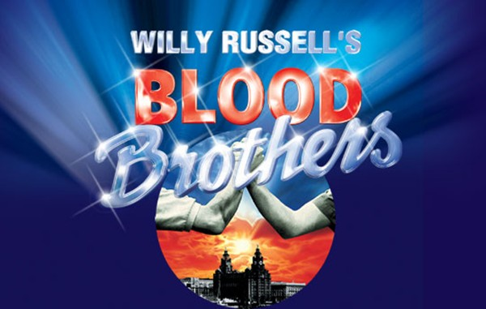
Section B- ‘Blood Brothers’

Slide 27
Section B- ‘Blood Brothers’ - Revision
Plot
Characters
Themes
Context
Russell’s key techniques – dramatic & structural

Slide 28
Section B- 50 minutes, 40 marks (32+8)
Choice of 2 questions
1 minutes selecting – CHOOSE THEME!
8 minutes planning
35 minutes writing
5 minutes proof reading

Slide 29
How does Russell present his ideas about childhood in ‘Blood Brothers?’ (40)

Slide 30
For a grade 4/5
The response shows a relevant personal response, soundly related to the text with focused supporting textual references.
There is an appropriate critical style, with comments showing a sound interpretation with focused supporting textual references.
Sound comment is offered on relevant contexts.
There is relevant comment on the relationship between text and context.

Slide 31
Mickey and Eddie born
Eddie comes back from first term at university
The Johnstone's move to Skelmersdale Lane
1945
1960(ish)
1974
1978
1983
Success criteria:
Summarise – key information only.
PRECISE information for BAND 5 – names, places dates & statistics.
Use one colour to plot REAL events and another to plot the FICTIONAL lives of Mickey and Eddie
Task:
Use the information on the context sheet to create a timeline of real events in Britain from 1945 until 1983. Then try to plot main events in the lives of Mickey and Eddie.

Slide 32
How to structure a Band 3+ theme answer
1 | Another place we see the idea of childhood in the play is where…….
2 | For example, ‘…………………………….’ + analysis
3 | At the time…………….(context)
4 | Ultimately Russell wants his audience to understand that…..

Slide 33
For a grade 6+
Aim for 5-7 points – interpretations of the theme (e.g. childhood is a time of innocence)
Russell firstly shows that childhood is fun and without responsibilities or a real grasp of the adult world. This can be seen in the repeated use of the idea of the children pretending to be cowboys or other characters with guns. In particular, Russell presents Mickey playing with an imaginary gun when we first meet him which is an example of foreshadowing; we get a glimpse of the violent turn his life will take. This is also an effective device for introducing the lack of true understanding about the power of guns and how initially the children see them as non-threatening, despite them being the cause of their deaths in the end. ‘But you know that if you cross your fingers And if you count from one to ten You can get up off the ground again. Ultimately, Russell is indicating that even as children, our futures can be mapped out based on our upbringing. Mickey’s decent into a life of crime and poverty was inevitable due to his inadequate secondary modern education, a lack of opportunities caused by poverty and the repercussions this would have trying to survive in a city with 25% unemployment.

Slide 34
IDEA | Evidence | Analysis/evaluation
Childhood is fun and free from responsibility | ‘Do you wanna be my ‘Blood Brother Eddie?
Childhood is a time of innocence | ’A plate. A dinner plate?’
Children do not appreciate the consequences of their actions. | ”you know that if you cross your fingers, and if you count from one to ten, you can get up off the ground again’ ‘the whole things just a game.’
Children are easily influenced by outside influences. | ‘Pissed off. You say smashing things, don’t you? Do you know any more words like that?’ ‘I wish I were our Sammy’ ‘play with matches’ ‘nudey women’ | Mickey has been exposed to bad language – different standards. Children like sponges. Juxtaposition of ‘Pissed’ and ’smashing’ stereotypical middle class vernacular. Keen to learn – in direct contrast to the apathetic teenage Mickey we see in Act 2 – secondary modern vs grammar.
Children are corruptible | ‘Adolf Hitler’ ‘You’re a fuck off’
Childhood is energetic
There is a close link between the child you were and the adult you become. | ’The dictionary. Don’t you know what a dictionary is?’ Same actors play the characters all of the way through
Environmental factors have a significant impact on a child’s development. | ’talk of Oxbridge’ ‘it’s a book that explains the meaning of words’

Slide 35
Some of Russell’s key messages
Childhood is fun and free from responsibility
Childhood is a time of innocence
Children do not appreciate the consequences of their actions.
Children are easily influenced by outside influences.
Children are corruptible
Childhood is energetic
There is a close link between the child you were and the adult you become.
Environmental factors have a significant impact on a child’s development.
Nurture is more important that nature
Class and money determine your future
The middle classes have an unfair advantage
Social mobility is difficult
Sometimes hard work is not enough to be successful
Education is power
Class prejudice is damaging
Society should have a stronger moral conscience
Class segregates
Middle classes don’t appreciate the value of money
Class and wealth do not automatically make you a better person (morally)
Gender is as suffocating as class

Slide 36
English Literature Paper 2 – 21st May 2020 (50%)
Section A: Jekyll & Hyde 55 minutes
Section B: Poetry anthology & unseen poetry – 1 hr 20
1 extract from anywhere in the novella – ‘How’ question.
1 question knowledge of whole novel (likely thematic) but could be setting or technique
One poem from conflict cluster – will have to compare to one other poem from cluster from memory.
2 unseen poems – comparative essay

Slide 37
What to revise
‘Jekyll and Hyde’
Anthology poetry
Plot – key events in each chapter
Characters – how to describe them, their development and role in the novella
Themes and how these are tracked across the novella, learn 3-5 quotes for each theme.
Context and how it has shaped Stevenson’s work
Writing frames
You do need to revise all 15 and at least know what they are about.
3-5 poems REALLY well (be strategic)
Learn 3-5 quotes for each of these poems
Key poetic terminology
Writing frame

Slide 38
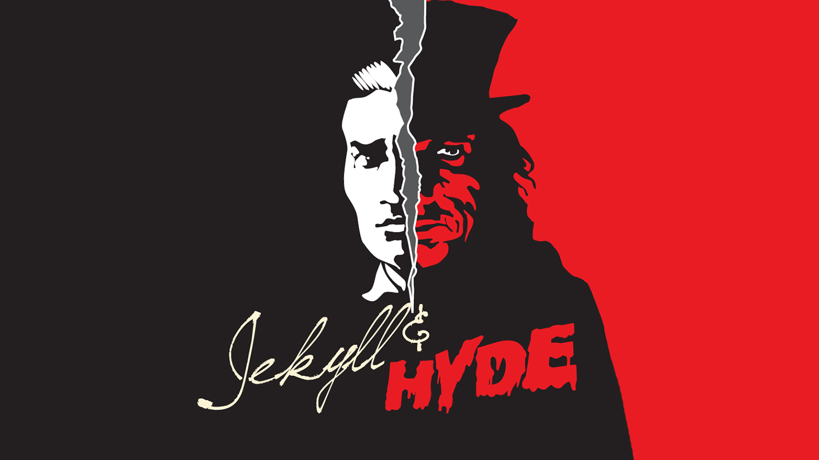
Section A

Slide 39
Section A
Question a = extract based. ‘How’ question marked on same criteria as Macbeth
Question B – knowledge of whole text – same as Macbeth!

Slide 40
Language, structure, techniques?
"He is not easy to describe. There is something wrong with his appearance; something displeasing, something down-right detestable. I never saw a man I so disliked, and yet I scarce know why. He must be deformed somewhere; he gives a strong feeling of deformity, although I couldn't specify the point.”
How does Stevenson use language and structure to present the character of Hyde?
Understanding the genre: what gothic feature do we see here?

Slide 41
Language, structure, techniques?
"He is not easy to describe. There is something wrong with his appearance; something displeasing, something down-right detestable. I never saw a man I so disliked, and yet I scarce know why. He must be deformed somewhere; he gives a strong feeling of deformity, although I couldn't specify the point.”
Structure; Short, snappy sentence – hooks us into the mystery
Technique: Triplet, repeating something – builds tension
Language: words linked to evil – most starting with ‘d’ – hint at the devil?

Slide 42
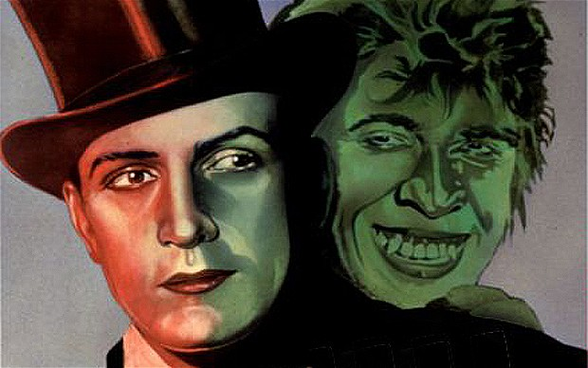
Duality
Stevenson suggests that we all have a dual nature.
Jekyll is conflicted between how he wants to behave and how he feels that he should behave.
Hyde is portrayed as an evil-looking dwarfed man with a violent temper, while Jekyll is a respected man of science, good-natured and leader of his circle of friends. Not only are these men two halves of the same person, but Jekyll describes them as polar opposites, one good and the other evil. However, once Hyde exists, he slowly seems to take over, to destroy Jekyll. Hyde's takeover of Jekyll seems to suggest a less clear-cut explanation, in which the human condition is not in fact double but rather one of repression and dark urges, and that once the repression of those dark urges eases or breaks it becomes impossible to put back into place, allowing the "true", dark nature of man to emerge.
Chapter 3:
“The large handsome face of Dr. Jekyll grew pale to the very lips, and there came a blackness about his eyes. "I do not care to hear more," said he. "This is a matter I thought we had agreed to drop.“
In this chapter, Mr. Utterson brings up Mr. Hyde to Dr. Jekyll. Instead of talking about the matter, Jekyll replies that he refuses to discuss Hyde in any capacity. Utterson is surprised by Jekyll's reaction, since Utterson is one of Jekyll's oldest friends.
Jekyll's behavior--i.e., his refusal to discuss his secrets--is indicative of the repressive, stuffy atmosphere of Jekyll's society: Victorian society in general, but particular his circle of bachelor friends and acquaintances. Like his friends, Jekyll refuses to disclose his sins, or even to allude to them. And yet even here, when Jekyll hasn't ingested any of the potion that transforms him into Hyde, Utterson can see some "blackness" in Jekyll. It's as if Jekyll's secret, sinful nature is struggling desperately to get out, affecting even his physical appearance.
Chapter 4:
“An ivory-faced and silvery-haired old woman opened the door. She had an evil face, smoothed by hypocrisy: but her manners were excellent. “
The police investigate Hyde's living quarters. An old woman with an evil, "hypocritical" face, lets the police into the room. The woman's face symbolizes some of Stevenson's ideas about the relationship between good and evil. All human beings have a secret desire to do evil, but most people learn how to control or at least conceal such a desire.
The old woman is a great example of a character who plainly desires to do evil, yet she is also an excellent example of the way society prevents people from giving in to their sinful desires. Good manners, it's suggested, help the old woman control her sinfulness--in other words, even though she's thinking nasty thoughts, she's able to conceal her thoughts beneath the facade of politeness. In a way, the old woman--and not Mr. Hyde--represents the real horror of Stevenson's novel. At least Mr. Hyde is clearly evil--someone like the old woman, who conceals her evil behind the appearance of goodness, can be far more dangerous in the long run.
Chapter 10:
“I looked down; my clothes hung formlessly on my shrunken limbs; the hand that lay on my knee was corded and hairy. I was once more Edward Hyde. “
Dr, Jekyll is sitting on a park bench in public and he finds himself transforming into Mr. Hyde, despite the fact that he hasn't drunk any of the potion. Thus far, Jekyll has believed that he can control his dual nature: he can be Hyde one day and Jekyll the next. Now, Jekyll begins to realize that he can't control his spirit at all: once Hyde has been released, there's no controlling him.

Slide 43
How to structure a Band 3+ theme answer
1 | Another place we see the theme of duality in the novella is where…….
2 | For example, ‘…………………………….’ + analysis
3 | At the time…………….(context)
4 | Ultimately Stevenson wants his audience to understand that…..

Slide 44
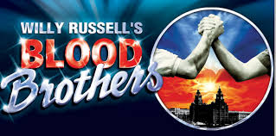
Resources needed for the set texts:
Copies of the books
Revision guides
Theme sheets
Quotes sheets
Knowledge organisers

Slide 45
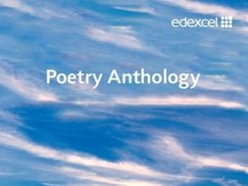
Section B= Poetry – 35 mins
Conflict

Slide 46
Catrin
I can remember you, child,
As I stood in a hot, white
Room at the window watching
The people and cars taking
Turn at the traffic lights.
I can remember you, our first
Fierce confrontation, the tight
Red rope of love which we both
Fought over. It was a square
Environmental blank, disinfected
Of paintings or toys. I wrote
All over the walls with my
Words, coloured the clean squares
With the wild, tender circles
Of our struggle to become
Separate. We want, we shouted,
To be two, to be ourselves.
Neither won nor lost the struggle
In the glass tank clouded with feelings
Which changed us both. Still I am fighting
You off, as you stand there
With your straight, strong, long
Brown hair and your rosy,
Defiant glare, bringing up
From the heart’s pool that old rope,
Tightening about my life,
Trailing love and conflict,
As you ask may you skate
In the dark, for one more hour.
Gillian Clarke (1978)
Section B.1 = 35 minutes
10 minutes planning
25 minutes writing
Re-read Catrin. Choose one other poem from the Conflict anthology.
Compare how tension is presented in the two poems.
In your answer you should consider the:
• poets’ use of language, form and structure
• the influence of the contexts in which the poems were written.
(Total for Question 9 = 20 marks)

Slide 47
It’s all in the planning
Find focus of question & decide on the poem you will compare with (30s)
Write down what you can remember about your revision poem (3mins)
Read the printed poem, highlight and annotate 3-5 quotes (be selective) label with S,M,I,L or E and decide in which section you will use them (5mins)
Go back to plan compare or contrast? (2 mins)

Slide 48
SMILE! | ‘Catrin’ | Compare/ contrast | ‘A Poison Tree’
STRUCTURE |  | In contrast | Iambic tetrameter ‘I told my wrath my wrath did end’ Trochaic trimeter – ‘I was angry with my friend (catalexis) meter at odds-reflect between foes/conflict Romanticism had with contemporary world/conflict between people and state – French revolution?
MEANING | Tension builds between a mother and child from the moment of birth through to adolescence | whereas | Tension builds between what we believe to be two peers when anger is not expressed and left to fester.
IMAGERY & TECHNIQUES |  | Likewise | Metaphor
LANGUAGE
EMOTIVE TONE |  | Alternatively

Slide 49
CONTEXT!
‘What Were They Like?’ – The Vietnam War
‘Exposure’ – World War One
‘The Charge of the Light Brigade’ – The Crimean War
‘The Man He Killed’ – ‘The Boer War’
Extract From ‘The Prelude’ – the Romantic movement, Wordsworth’s difficult childhood

Slide 50
Literature – Poetry content
You don’t have to know all 15 by heart – re-read them all but try to learn between 3-5 well!
WAR – ‘Charge of the Light Brigade’
SOCIAL – ‘The Class Game’
POLITICAL – ‘Belfast Confetti’
MORAL – ‘War Photographer’
Learn your techniques!

Slide 51
Success criteria for 4+
Plan
Must write about 2 poems to get above a grade 3
Have to show an understanding of structure and the effects of structural choices
Must analyse language – single word analysis
Must show a sound understanding of poetic terminology
RANGE of comparisons
Must show an awareness of context

Slide 52
Section B.ii = unseen poetry
45 minutes
Same process but slightly longer
Same marks scheme BUT no need to have an awareness of context.
Must plan first
NO NEED FOR CONTEXT

Slide 53
Alliteration Enjambment Ode Allusion Parody Full rhyme Assonance Consonance Caesura Narrative Euphemism End stopped line Free verse Imagery Irony Heroic couplet Elegy Juxtaposition Metaphor Iambic pentameter Epic Extended metaphor Onomatopoeia Internal rhyme Ballad
Oxymoron Paradox Repetition Dramatic monologue Personification Refrain Sonnet Simile Symbol Tercet Quatrain Lexical field Pathetic fallacy Trochee/troaich Sibilance Spondee/spondaic Catalexis Stanza Blank verse Hyperbole Tone Rhyme Rhythm
In your exam you will have to be able to comment on the STRUCTURE and FORM of a poem, choices of language and the poet’s use of TECHNIQUE for effect.
Using the list of poetic terms to the left, create a ‘poet tree’ like the one at the back of the room.
Each term must:
Be spelt correctly
Have a definition (use displays, poetry placemats and dictionaries to help)
Must be colour coded correctly GREEN = techniques
ORANGE= form (type of poem)
YELLOW = structural feature
This needs to be finished for prep. It must be neatly presented. You will be tested on some/all of these terms most lessons!

Slide 54
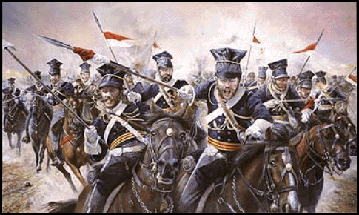
Alfred Tennyson –’ Charge of the Light Brigade.’
CONTEXT
The Crimean War fought between Britain & Russia from 1853-1856.
The most significant moment in the Crimea =Battle of Balaclava.
Order given to the British army's cavalry (the Light Brigade) was misunderstood & 600 cavalrymen charged down a narrow valley straight into fire of Russian cannons. & more than 120 were wounded.
At home news of the disaster was a sensation & a nation that had until then embraced British military exploits began to question the politicians and generals who led them.
FORM - NARRATIVE
EMOTIVE TONE
Tennyson admires the bravery of the Light Brigade. They took orders and sacrificed their lives and the poet believes that this sacrifice should be acknowledged.
Tennyson is also in disbelief and shock at the stupidity of the order but this doesn’t take away from his respect for the soldiers.
Horror – there is a suggestion that the poet is horrified by the violence of the battle
People in awe of the ‘600’ - ‘all the world wonder’d’
THEMES
Obedience
Patriotism
Sacrifice
Heroism
Romance of war
STRUCTURE
3rd person
A strong, regular, relentless rhythm which creates a fast pace, imitating the cavalry charging forward with energy and gusto.
Chronological order.
Some lines are repeated which keeps the focus on the British troops throughout the battle. Repetition creates a sense of impending doom.
The first three stanzas end with the same line giving a sense of foreboding.
Anaphora – ‘Canon’ reinforces their dismal situation – trapped.
Irregular rhyme scheme echoes the chaos of battle
LANGUAGE
‘wonder’d’ the repetition of this word throughout the poem emphasises people’s amazement at their bravery.
The repetition of ‘flash’d’ and the rhyme create a powerful image of them using their swords.
‘Blundered’ hints that the mistake was careless and could’ve been avoided
MEANING
At times ambiguous – celebrating glory of war or questioning those in chage?
The poem seems to be more concerned with creating national heroes for a nation than mourning the dead soldiers or arguing against the war.
IMAGERY/TECHNIQUES
Allusion – ‘Valley of the shadow of Death’ – biblical reference (Psalm 23) shows the significance of the event, God is on the side of the brave?
Alliteration ‘shot and shell’ creates the sound of ammunition firing
Onomatopoeia – sounds from the battlefield.
Metaphors – ‘jaws of death’ gives the reader the idea that death is a creature which the soldiers can’t control or escape from.

Slide 55
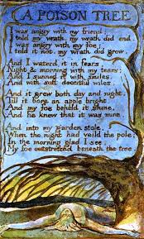
William Blake – A Poison Tree
CONTEXT
Blake was originally an engraver.
In 1789 he published Songs of Innocence and Experience showing the two contrary states of the human soul.
Songs of Innocence poems = hopeful, positive
Songs of Experience (incl. A Poison Tree) = negative, pessimistic; presents the world as harmful, cynical and exploitative, especially of young children. Blake once claimed that his ideal reader was a child.
Blake was a follower of Swedenborg, a Swedish mystic, philosopher, theologian, and scientist who said that the spiritual world and the natural world were joined—that the tangible objects of the natural world were actually physical instances of spiritual realities.
He thought human beings could communicate with spirits & Blake spoke to the spirit of his younger brother Robert after Robert's death.
Swedenborg taught that God is the source of love and wisdom. The Christian church leads humankind away from God. That loss of touch with God is the Fall.
Blake’s work often protested against social injustices and the negative effects of the Industrial Revolution.
Big fan of The French Revolution (1789), saw this as energy bursting from oppression but had to write symbolically to avoid being accused of sedition.
1790s: In his poetry, Blake opposes the emotional repression advocated by the morality of his time and posits that it has harmful spiritual, social, and individual effects
FORM – Quatrains (4 verses, 4 lines = simplest poetic form
LANGUAGE & EMOTIVE TONE
Short, simple words & sentences suggest strong, obsessive feelings.
The first stanza shows simple opposites ‘friend' ‘foe‘ (both ‘f’)
Introduces strong emotions: ‘angry' and ‘wrath'.
Each line begins with ‘I', suggesting also the speaker's obsession with himself. ‘I' ‘my' and ‘mine'.
The foe is given no name; what is important is his relationship to the speaker.
The negativity of the speaker is implied in stanza two. His only true emotions are ‘fears’ and ‘tears’.
All that is positive is false – the sun of ‘smiles’, and the softness of ‘deceit’. Concealment is achieved through the language, as we do not see what is growing until the apple appears. It suggests that the nature of what is being nurtured is only apparent when it is fully developed, even to the one who nurtures it.
THEMES
Anger, revenge, death
Correspondence – spiritual world v. real world
Contraries – friend v foe, reason suppressing anger/ energy leads to hypocrisy
MEANING - 2 meanings
1. DENOTATION: simple tale of a man who lets his anger build up until he kills his ‘foe’ with a poisoned apple in his garden; moral - tell your ‘friend’ how you feel to avoid anger festering
2. CONNOTATION: an allegory for revolution (French)
Blake has inverted/ reversed the morality of his time. By suppressing anger/ energy with reason, we create war/ destruction. Let anger out or people will rise up and kill – a warning to the British government
IMAGERY/TECHNIQUES
Metaphor: tree/ apple the growing tree represents anger. It bears a poisoned apple – allusion to the Garden of Eden. By the end of the poem the apple is REAL – the enemy eats it and dies.(Correspondence – spiritual world becomes the real/natural world through the human’s feelings)
Garden of Eden = deadly place (inversion)
Structure
The stanzas are rhymed closed couplets. Each stanza after the opening one begins with ‘And', as do many of the lines. The trochaic metre of stanzas two, three and four emphasises this word, thus increasing the obsessive drive of the poem. When the metre alters to iambic, in l.2, 4 and the final line, there is a sense of the forward momentum decelerating, as the situation is summed up. The regularity of the tetrameter is only broken once with the omitted syllable in l.7 before ‘smiles', which has the effect of ‘wrong footing' the reader, just as the smiles themselves are designed to trip up the speaker's enemy. The sibilants of the second stanza also indicates the presence of lurking evil.

Slide 56
William Blake – A Poison Tree
CONTEXT
FORM –
LANGUAGE & EMOTIVE TONE
THEMES
MEANING - 2 meanings
IMAGERY/TECHNIQUES
Structure

Slide 57
 | POINT | QUOTE | ANALYSIS
S | Uses 2 different types of meter to present conflict | ‘I told my wrath my wrath did end’ I was angry with my friend’ | Iambic tetrameter vs Trochaic trimester (catalexis) meter at odds-reflect between foes/conflict Romanticism had with contemporary world/conflict between people and state – French revolution?
M
I
L
E

Slide 58
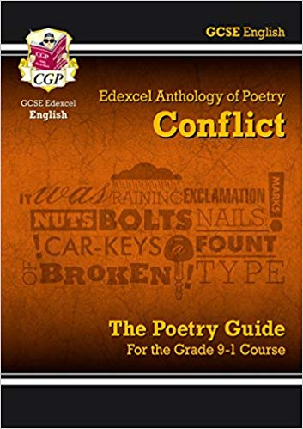
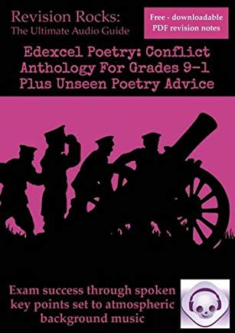

Slide 59
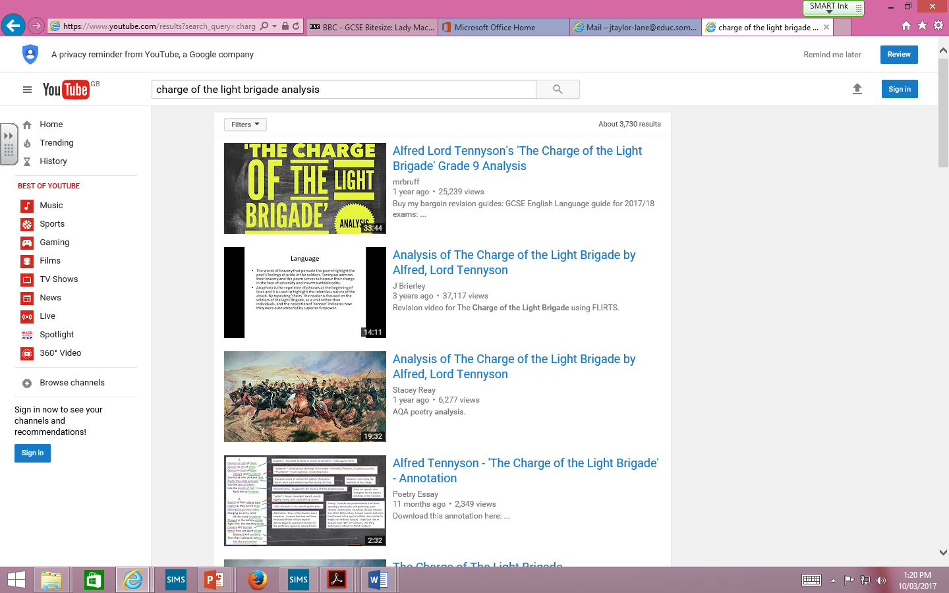

Slide 60
What and how to revise for Literature

Slide 61
For each text you must revise and have an understanding of:
Context
Plot & chronology
Characters
Settings
Themes

Slide 62
Context
MACBETH | BLOOD BROTHERS | JEKYLL & HYDE
The real Macbeth James I & The Divine Right of Kings Role of witchcraft in Jacobean society Gunpowder Plot & significance of treason The role of men and women in Jacobean society | Willy Russell Liverpool The people/culture of Liverpool Politics – Margaret Thatcher & the conservative party Education – grammar vs secondary modern Poverty Council housing ‘New towns’ | Stevenson Victorian London Victorian gentlemen Religion Science Jack the Ripper – duality of man

Slide 63
Plot & chronology
Timeline/flow chart
Comprehension questions (already been given them & in subject resources)

Slide 65
Character profiles
MACBETH | BLOOD BROTHERS | JEKYLL & HYDE
Macbeth Lady Macbeth Banquo Lennox Witches/Hecate | Mickey Edward Mrs J Mrs L Sammy Linda | Jekyll/Hyde Utterson Lanyon Poole

Slide 66
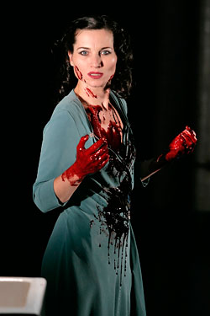
Cruel
She would “dash the brains out” of her own child
She is calculating She says look "innocent" but be a "serpent"

Slide 67
Themes
Where we see it
Quotes
Author’s message/point
Link to context
Make themes maps/practise writing theme answers.

Slide 68
Macbeth, although undoubtedly influenced by his wife in the following scene, in Act 1 scene 4 he shows through his own free will that he is ambitious independently of his wife. King Duncan announces his heir and makes Malcom the Prince of Cumberland. Macbeth reveals his sinister ambitions for the first time. He says “The Prince of Cumberland! That is a step On which I must fall down or else o’erleap” and “For in my way it lies.” “Stars, hold your fires, Let not light see by deep and black desires.” Shakespeare uses a metaphor to reinforce that even Macbeth knows this ambition is wrong, comparing Malcolm to a step dehumanises him. This is further supported by him acknowledging that his desires are ‘black’ and he wants them to remain hidden. In Jacobean England it was treason to even speak of the death of a king. To challenge the role of a king was to challenge the word of God as they believed in the Divine Right of Kings. As a deeply religious society people may be able to face the wrath of a king, but were unlikely to accept the eternal damnation of their soul
We first see LM’s ambition in Act 1 scene 5 when she reads the letter sent to her by her husband telling her of the three prophesises the witches made. It is her ambition that makes her decide that her husband ‘shalt be what thou art promised.’ We also see the lengths she will go to to see her ambitions fulfilled. She asks the spirits to ‘unsex me here and fill me from the crown to the toe top full of direst cruelty.’ It is in this scene that Lady Macbeth plots the murder of Duncan and sets about manipulating her husband into complying with her treasonous plans. This would have been disturbing to a Jacobean audience who saw women as the weaker sex; the thought of them interfering in the world of politics, let alone questioning her husband’s masculinity, would have been unthinkable. Lady Macbeth also seems to have links to the supernatural, women were believed at the time more likely to be witches. Women manipulating men and leading them astray is nothing new, stemming from Eve’s actions in the Garden of Eden.
The witches first speak Macbeth’s ambition in Act 1 scene 3 when they predict that he will become Thane of Cawdor and then ‘hail king that shalt be.’ This would have appealed to a Jacobean audience who believed in witches and believed them to be ruled by the dark forces of the devil who looked to lead people astray. King James would also have identified with the witches as he especially had an interest in them, so much so he wrote a book about them called Demonologie.
Ambition
Banquo could also be argued to be ambitious in Act 3 scene 1 when he says ‘why, by the verities on thee made good, May they not be my oracles as well, And set me up in hope?’ He starts to think that as the witches predictions regarding Macbeth have come true maybe he really could be father to a line of kings. Banquo here is used as a contrast to Macbeth. Macbeth allows his ambition to corrupt him whereas Banquo’s ambition is constrained by his morals, ‘But hush! No more.’
Macbeth proves the lengths that he will go to in order to see his ambition come to fruition in Act 2 scene 2 when he commits regicide and murders Duncan. Although he has doubts and his feelings of guilt cause him to hallucinate, ‘is this a dagger I see before me?’, this doesn’t stop him. The consequences of ambition can already start to be seen Lady Macbeth says she ‘heard the owl scream and the crickets cry.’ ‘Scream’ echoes the horror of the murder and the pain that must have been endured by Duncan. ‘Cry’ suggests that nature if mourning the upset of the natural order of events. The killing of the king would have been deeply shocking to an audience who had just witnessed the attempted murder of their own king, James I by Guy Fawkes and his fellow catholic conspirators in 1605.
Ultimately Shakespeare’s message is that ambition is dangerous, especially to have ambitions above your station. This is clear by the fates of both Macbeth and Lady Macbeth. Macbeth becomes increasingly paranoid, ‘full o’scorpions is my mind.’ The witches second set of predictions lead to Macbeth becoming arrogant and overconfident – he believes he is invincible. His ambition leads to his downfall – it is his fatal flaw. Lady Macbeth, although seemingly the stronger of the two at the start, becomes mad with the guilt caused by her ambition and kills herself in Act 5 scene 1. This would have been a poignant message to audiences who may contain any conspirators who sought to replace the new Protestant king.
Macbeth’s ambition changes from wanting to become king to wanting to retain his power at all costs. As soon as he commits his first murder it sets in motion a chain of events which see his actions become increasingly brutal. For example the murder of Banquo and planned murder of Fleance his son in Act 3 scene 3. Perhaps most shocking is the murder of Lady Macduff and all the Macduff children in Act 4scene 2.His ambition also prompts him to revisit the witches again.

Slide 69
How does Russell explore the theme of superstition and fate in Blood Brothers?
Russell shows that superstitious belief is very powerful and potentially dangerous.
Shows that the superstition Mrs Lyons tells Mrs Johnstone at the start of the play will come true.
People didn’t have control over their circumstances at the time.
The Narrator’s song Shoes upon the Table, reminding the mothers of their guilt and the consequences of splitting up the twins. Constant superstitious symbols add to the rising sense of panic and foreboding.
The deaths of Mickey and Edward are shown to be inevitable from the opening scene of the play. No matter what they do, nothing can change their destiny.
The Narrator is used to remind both the audience and the boys’ mothers of the curse that they have brought upon Mickey and Edward.
Superstition is linked to social class, first through Mrs Johnstone being superstitious; whereas Mrs Lyons isn’t and secondly through the Narrator’s final comments about what is really to blame for the death of the twins.
And do we blame superstition for what came to pass? Or could it be what we, the English, have come to know as class? The role of superstition is primarily a device to support Russell’s view that one’s success was dependent on one’s class. The middle classes had the better education, qualifications, jobs, earning potential and standards of living. In contrast, the working classes had the exact opposite, what with the closing of traditional manufacturing and mining industries, they were destined to be trapped in a relentless cycle of poverty and deprivation. Superstition, to an educated, rational person, is not something to be taken seriously. Hence rendering Russell’s perhaps most famous quote from the play as a rhetorical question – class must be to blame for the tragedy.
Mrs Johnstone is superstitious Mrs Johnstone is horrified when Mrs Lyons places new shoes on the table, revealing that she is superstitious. “You never put new shoes on the table.” Superstition is immediately linked to the working class, because Mrs Johnstone is superstitious whereas Mrs Lyons isn’t. This gives Mrs Lyons power over her employee when she wants to make sure that Mrs Johnstone doesn’t tell anyone about the twins being split up. To do this she makes up a superstition about the twins Mrs Lyons uses her knowledge that Mrs Johnstone is superstitious to ensure that she does not tell anyone about giving away one of the twins. “They … they say that if either twin learns that he once was a pair, they shall both immediately die.” This becomes a self-fulfilling prophecy. This is dramatic irony because the audience is already aware that the twins will die because of the opening of the play, so everything that happens is linked to this. Although Mrs Lyons has invented the superstition, her behaviour actually leads to the tragedy of Mickey’s death because she is the one to point out to him that Edward and Linda have betrayed him. During the time when Mrs Johnstone would have grown up, in the 1950s and 1960s the education system favoured the middle and upper classes. Mrs Johnstone would have attended a secondary modern which would have likely been attended by children from a deprived area with little or no aspirations. Behaviour would have likely to have been poor and achievement low. Without a good education, people like Mrs Johnstone would become trapped in a cycle of poverty with no way of being able to improve their lives.

Slide 70
Ambition
Act 1 scene 7:
‘I would while it was smiling in my face have ripped my nipple from its boneless gums and dashed its brains out, had I so sworn as you have done to this.’
Act 1 scene 4:
“stars hide my fires, let not light see my deep and dark desires”
“that is a step which I must o’leap”
Act 1 scene 5:
“Glamis thou art, and Cawdor; and shalt be What thou art promised. “
Act 3 scene 1:
“Thou hast it now: king, Cawdor, Glamis, all As the weird women promised, and I fear Thou played’st most foully for ’t”
Context to link:
Divine Right of Kings
Regicide & heresy
Penalty for treason
Court corruption
Society guided by strong religious beliefs

Slide 71
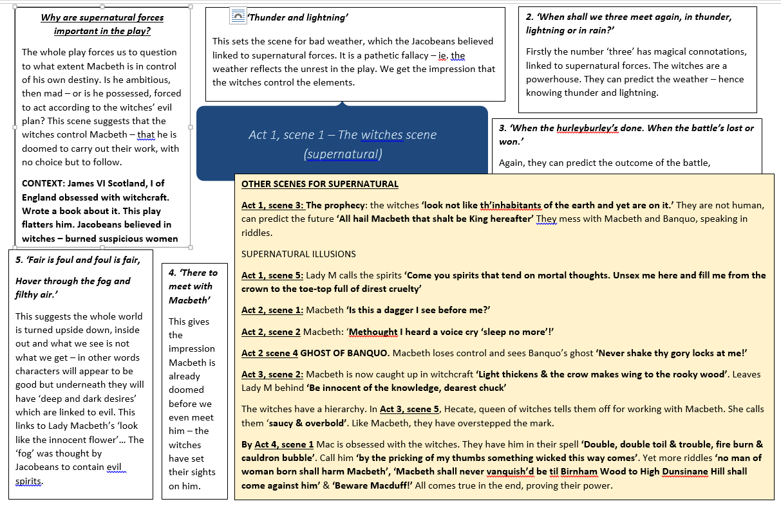

Slide 72
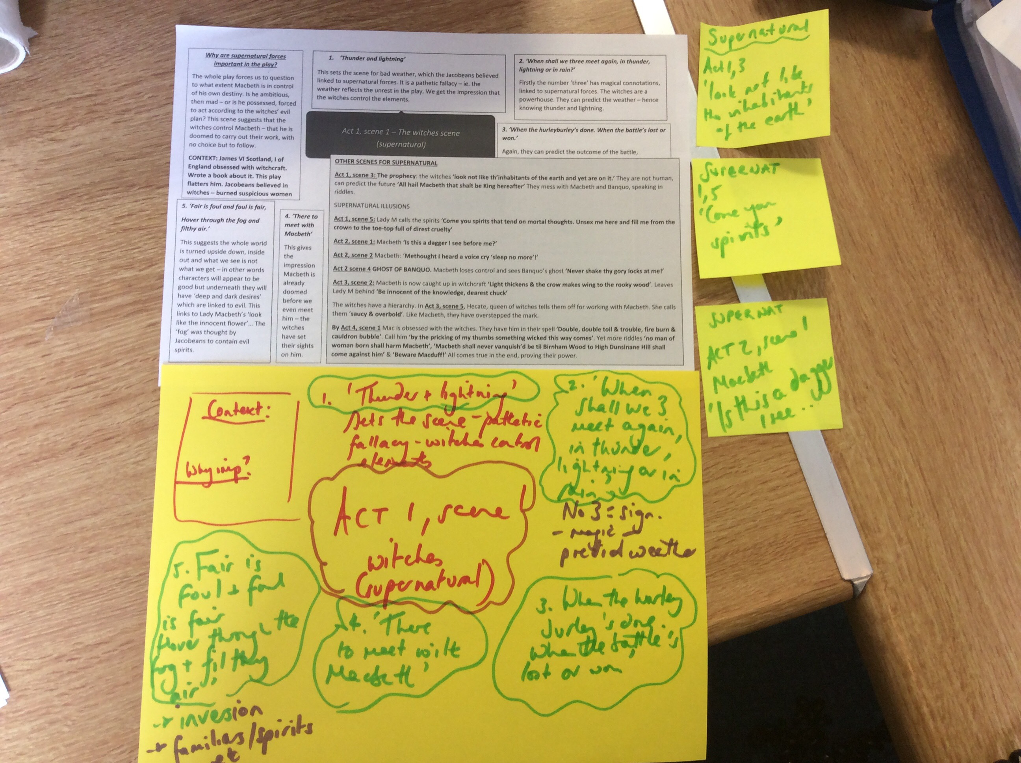

Slide 73
CHANT IT
X 10

Slide 74
TEST IT
GIVE ME 5!

Slide 75
In summary
Re-read texts
Plot timelines x3
Context all 3 texts – posters/flashcards/mind maps
Settings
Character profiles for main characters from all texts
Theme mats
3-5 poems from anthology
Techniques & terminology
How we write to compare

Slide 76
Spring Half term Suggested English Revision
QUOTES! QUOTES! QUOTES!
THEMES! THEMES! THEMES!
Handy tips for family support
Watch Polanski’s ‘Macbeth’ movie together – on YouTube. Type ‘Polanski’s Macbeth Part 1’
Watch Blood Brothers on you tube together. Type ‘Blood Brothers Part 1’, listen to the soundtrack – on repeat!
10 mins – create a poster. 10 mins – chant 5 quotes – 10 mins – test yourself.
Learn your chosen poems
Download ‘Jekyll and Hyde’ audio book – learn themes & quotes
Keep track of Countdown Calendar – straight into exams when boys come back.

