Slide 1
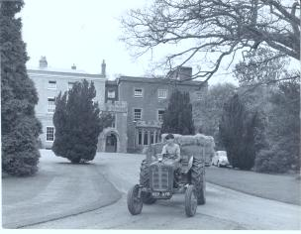
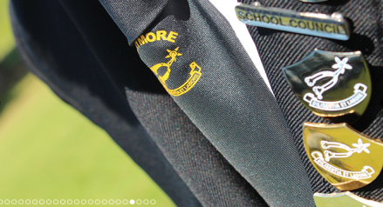
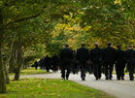
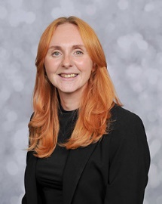
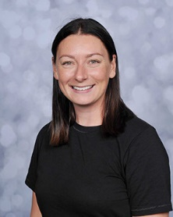
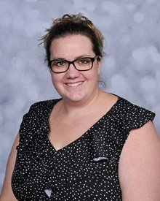
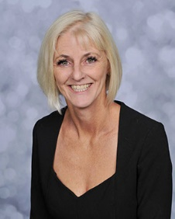
Pupil concerns
Pass on your concerns to……
If you are concerned or worried about your welfare or someone else’s: you must…
Miss Chloe Doble
Assistant Head and
Designated Safeguarding Lead
Mrs Harriet Featherstone
Deputy Head of Boarding and Deputy Safeguarding Lead
Or any member of staff
Rod Cockram is Brymore’s Independent Listener he can be contacted by;
E mail: IL@brymoreacademy.co.uk
Call or Text: 07714 171939
Miss Lisa Gardner
Safeguarding and Pastoral Administrator (maternity cover)
Mrs Debbie Roberts
Safeguarding Officer and
Deputy Safeguarding Lead
Mrs Charlotte Wade
Governor lead for Child Protection and Safeguarding: WADEC@btc.ac.uk
0300 123 2224
childrens@somerset.gov.uk
Mrs Sally Power
Trust Safeguarding Lead
07867976901

